Slide 1
Mt Hawthorn Community Church
19th August 2018
Allan Tranter

Slide 2
Readings
1 Corinthians 1 : 18 - 25/31
  Jews demand signs / Greeks looking for wisdom
2 Corinthians 5 :11 – 6 : 2
  Christ’s Ambassadors

Slide 3
  Openness
  New Ideas
  New Elites
  New Circumstances
  New Opportunities
  Formed by the collective desires and actions of its members
  Equality
  Openness needs a steadily advancing notion of equality in order to have the whole work
  Not just wealth but also of political rights
  What Kept The Idea Of ’The West’ Strong?

Slide 4

INSIGHT
“ Without openness ‘The West’ cannot thrive, but without equality ‘The West’ cannot survive.”
Bill Emmott

Slide 5
FAITH in society
HOPE for the future
TRUST in the system
(government institutions)
Optimistic | Strive | Participate | Contribute

Slide 6
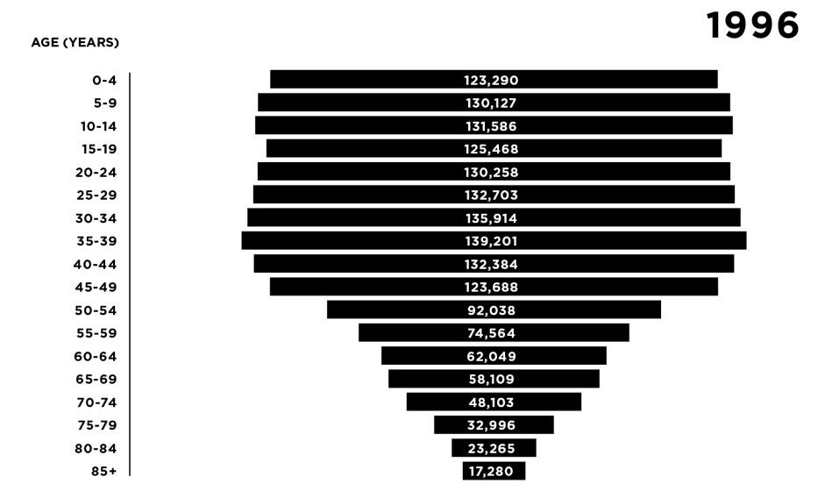
We now have middle age spread
  OUR AGE COHORTS ARE CHANGING
Age Cohorts, Western Australia, 1996 and 2016
1 in every 6 people in WA are aged over 65
Our population now has a “middle-aged spread”
Source: ABS Census Data, 2016
Notes:
1 in every 6 people in WA are aged over 65
The Australian population now has a “middle-aged spread”

Slide 7
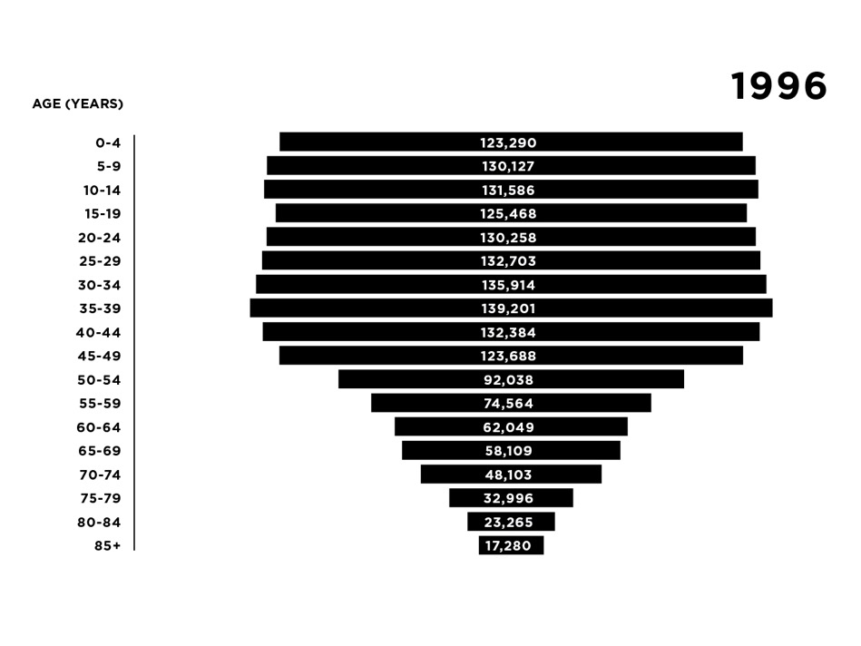
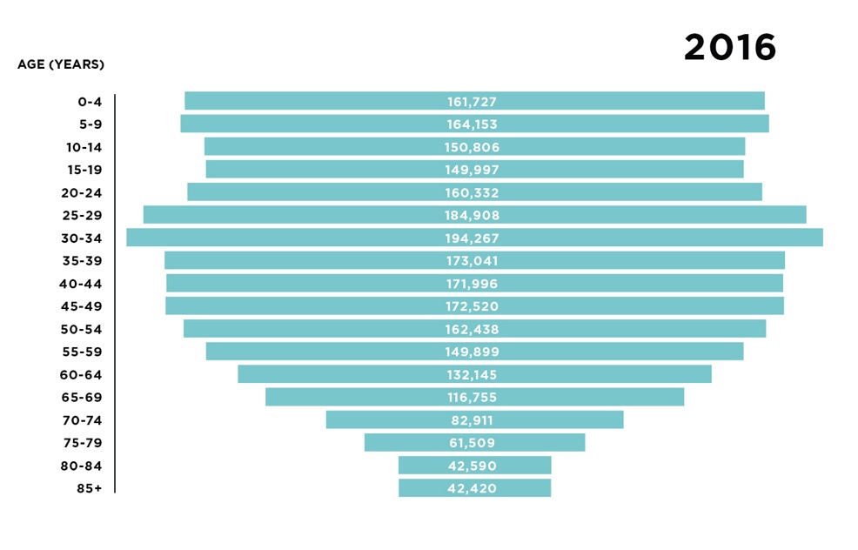
We now have middle age spread
  OUR AGE COHORTS ARE CHANGING
Age Cohorts, Western Australia, 1996 and 2016
1 in every 6 people in WA are aged over 65
Our population now has a “middle-aged spread”
Source: ABS Census Data, 2016
Notes:
1 in every 6 people in WA are aged over 65
The Australian population now has a “middle-aged spread”

Slide 8
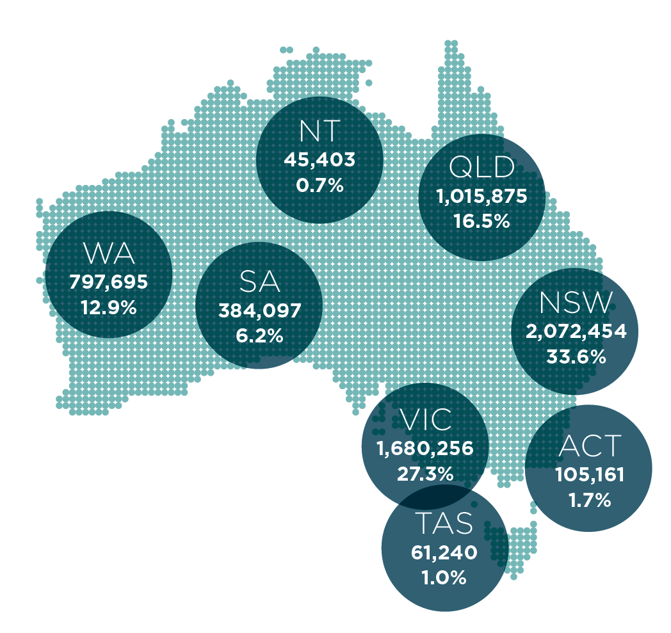
IN AUSTRALIA
  AND OUR MIGRATORY PATTERNS ARE SHIFTING
Overseas-Born Population Residing in Each State and Territory, 2016
Less people are migrating from England and Ireland and more people are migrating from India and China – more people who are used to shared living a
Of the 6,163,667 overseas-born persons in 2016, nearly one in five (18%) had arrived since the start of 2012

Slide 9
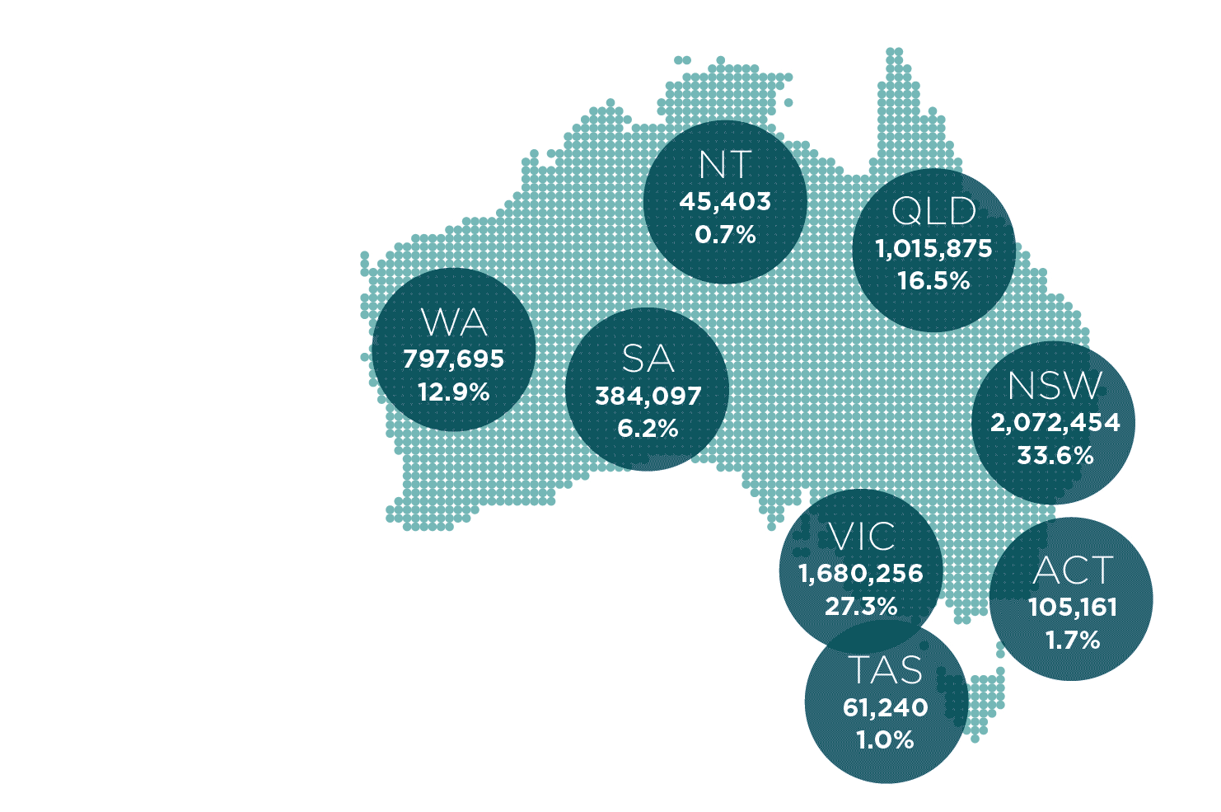
  AND OUR MIGRATORY PATTERNS ARE SHIFTING
IN WESTERN AUSTRALIA
32% of our population is born overseas
The top languages spoken (other than English) are now – Mandarin, Italian, Vietnamese and Cantonese

Slide 10
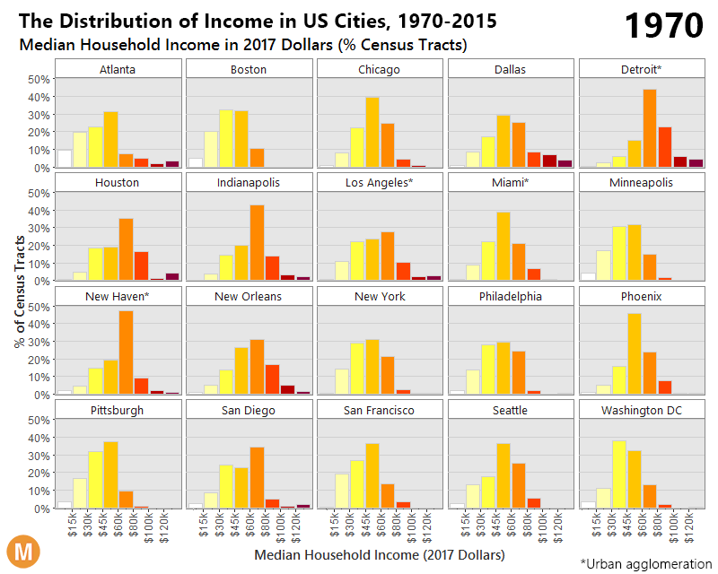
  IN THE U.S., THE MIDDLE CLASS IS DISAPPEARING

Slide 11
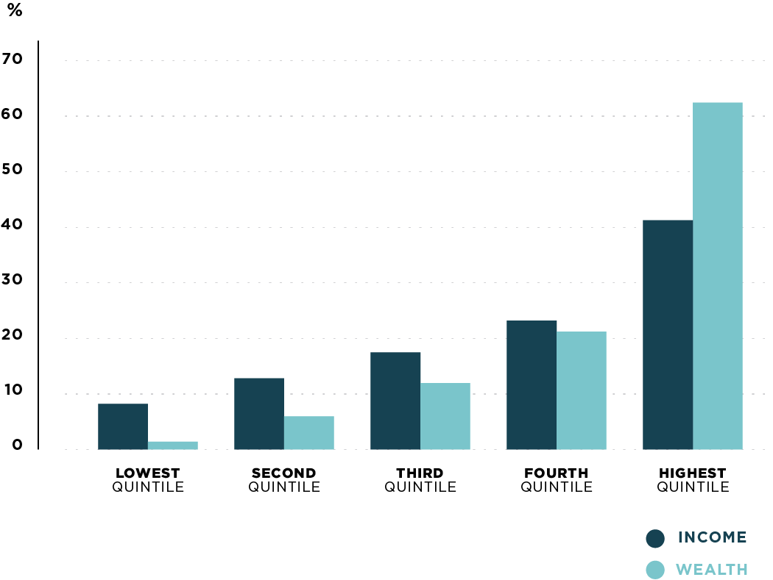
Australia’s Share of Income and Wealth Per Quintile, 2013-14
  IN AUSTRALIA, THE RICH HAVE BECOME RICHER WHILE MIDDLE AND LOWER CLASSES HAVE STAGNATED
Incomes of Australia’s lower 4 quintile brackets are flat-lining
Only the top 20% have been able to build wealth
The top 20% of households earn 49% of all income and own 62% of all Australia’s private wealth

Slide 12
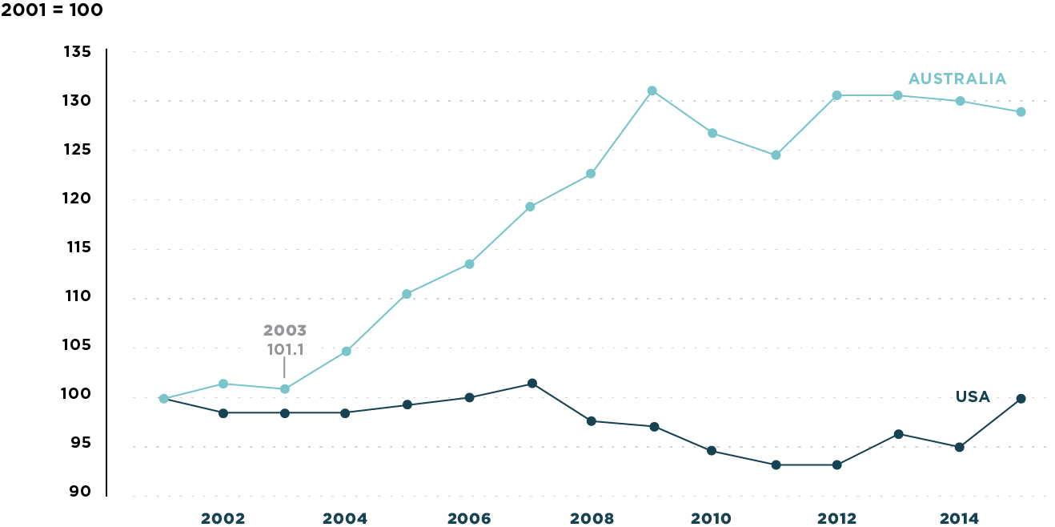
Real median household incomes since 2001: USA v Australia
  WE NEED TO BE WARY OF REPLICATING THE U.S.’S INCOME STABILISATION TREND
Source: Household, Income and Labour Dynamics in Australia (HILDA) survey, 2017

Slide 13

  PERTH STILL HAS RELATIVELY HIGH MORTGAGE STRESS
Perth has the third highest rate of mortgage stress in Australia
One in ten households spend more than a third of their income on mortgage repayments

Slide 14
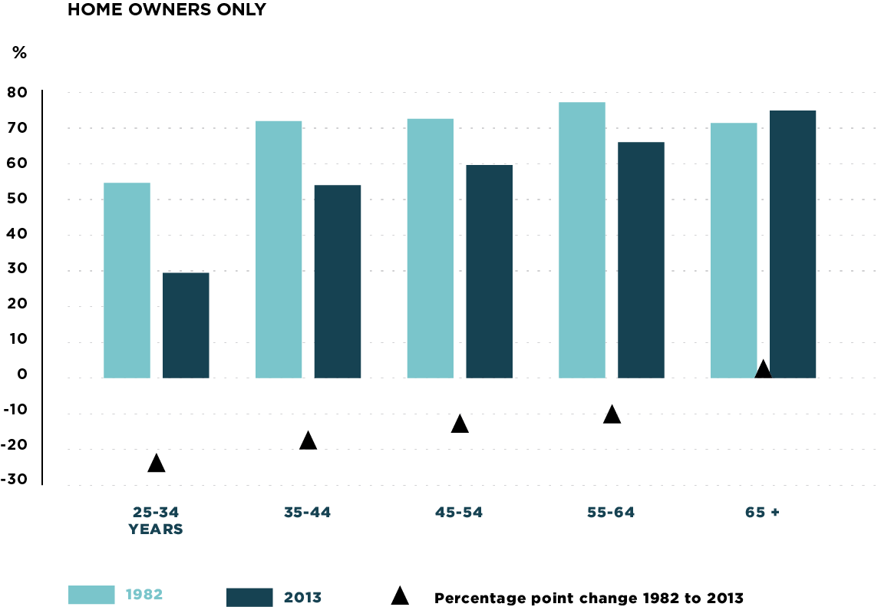
Share of Property Ownership by Age Group
1982 and 2013
  AND FEWER YOUNG PEOPLE ARE ABLE TO BUY HOMES
Young people are unable to access the property market and build wealth
Home ownership rates for under 35s has dropped from 60% in the 1980s to 45% in 2016

Slide 15
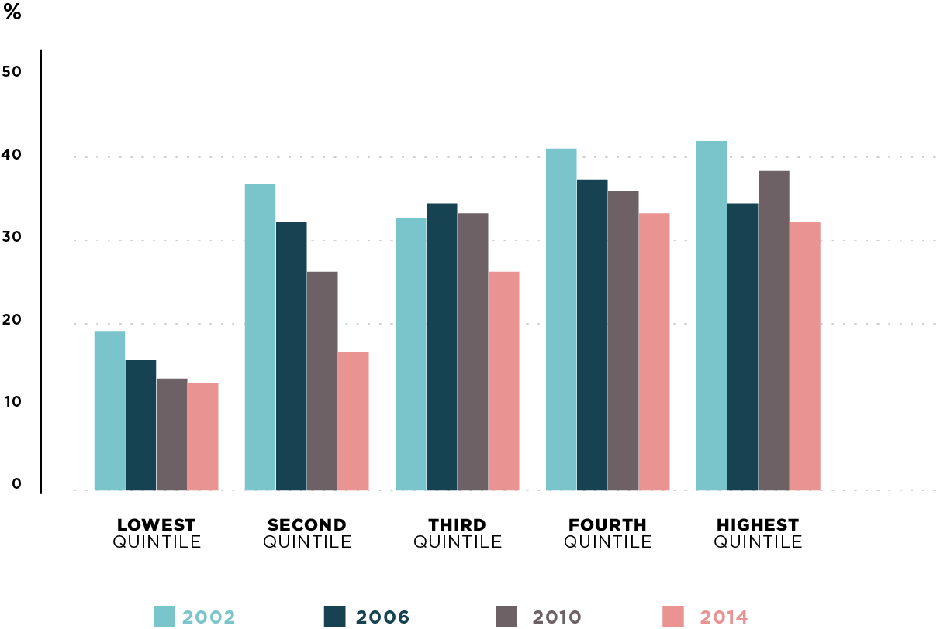
Home Ownership of Under 40s by Income Quintile
  AND FEWER YOUNG PEOPLE ARE ABLE TO BUY HOMES
For those under 40, home ownership has decreased most starkly in the poorest 40% of the population
Affordable rentals
are on the decline

Slide 16
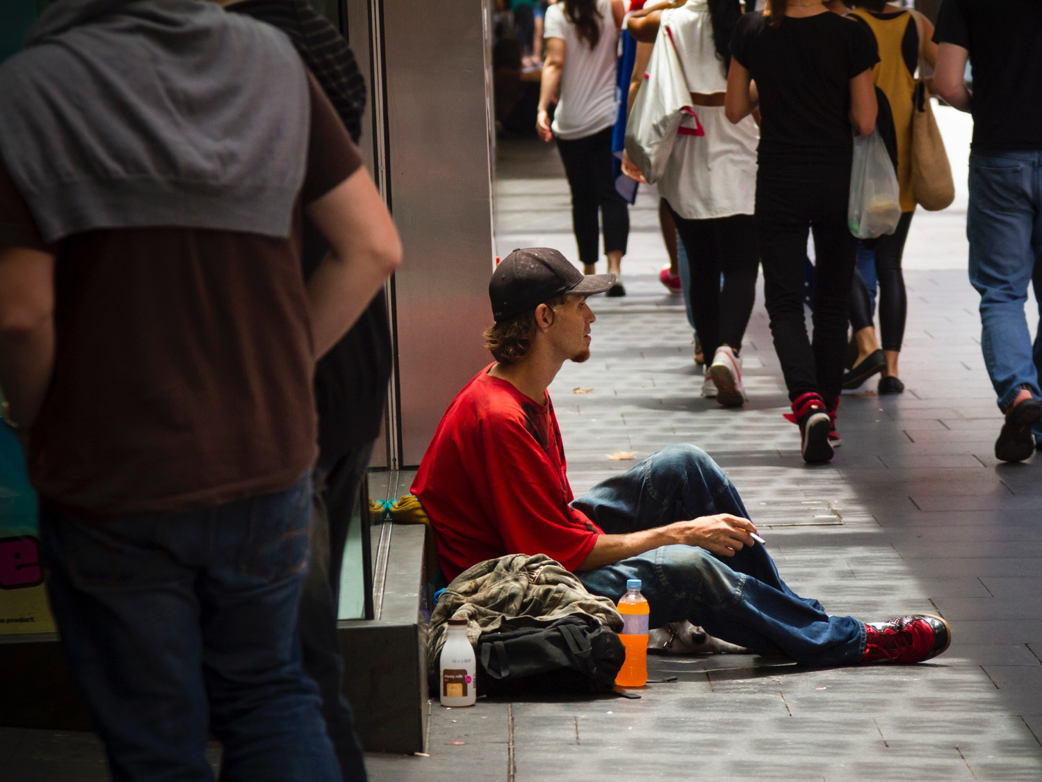
  HOMELESSNESS CONTINUES
  TO BE AN
  ISSUE IN WA
Around 9,595 people are experiencing homelessness in WA
4,909 of these people are living in the greater Perth area

Slide 17

In Lifeline’s National Stress Poll (2015), more than half of the study’s respondents indicated that they experienced at least some stress due to:
  work
  thoughts about the future
  finances
  health
  AND PEOPLE ARE UNDER MORE STRESS

Slide 18
Deloitte 2017 Millennial Survey
“ Apprehensive millennials: seeking stability and opportunities in an uncertain world.”

Slide 19
WA Health Report
“ More than one third of parents needed help for emotional problems of their children… up from 20% in 2002.”
Source: Cathy O’Leary and Bethany Hiatt (2017, September 1). WA records its high rate of obesity. The West Australian. Retrieved from https://thewest.com.au

Slide 20
People are:
Vic Health advocate to enhance mental well-being by:
Social inclusion – community connectors, networks, supportive relationships
Freedom from violence and discrimination
Access to economic resources and participation in work, education and housing
Individuals with well-developed social skills.
Concerned
at the global level (today – ISIS/North Korea/Trump)
Stressed
at the local level
Worried
about their future

Slide 21



1. People want to live in AI communities
  EMERGING TRENDS

Slide 22
“ AI programs exhibit racial and gender biases, research reveals”

Slide 23



2. Communities will increasingly want to own and profit from their own data.
  EMERGING TRENDS

Slide 24
PURPOSE
“ Thick data, the precious, unquantifiable insight from actual people to make the right business decisions and thrive on the unknown.”
Tricia Wang

Slide 25
PURPOSE
“ Every time we remove a role or responsibility from a person we give them one less reason to exist.”

Slide 26



3. People wanting to become part of the “collective us.”
  EMERGING TRENDS

Slide 27

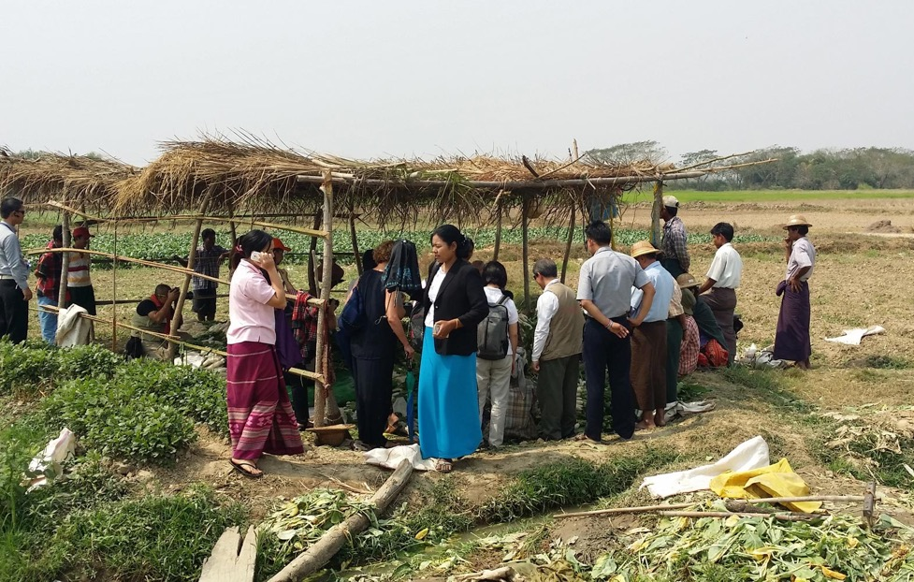
Glocal
BIG & SMALL

Slide 28
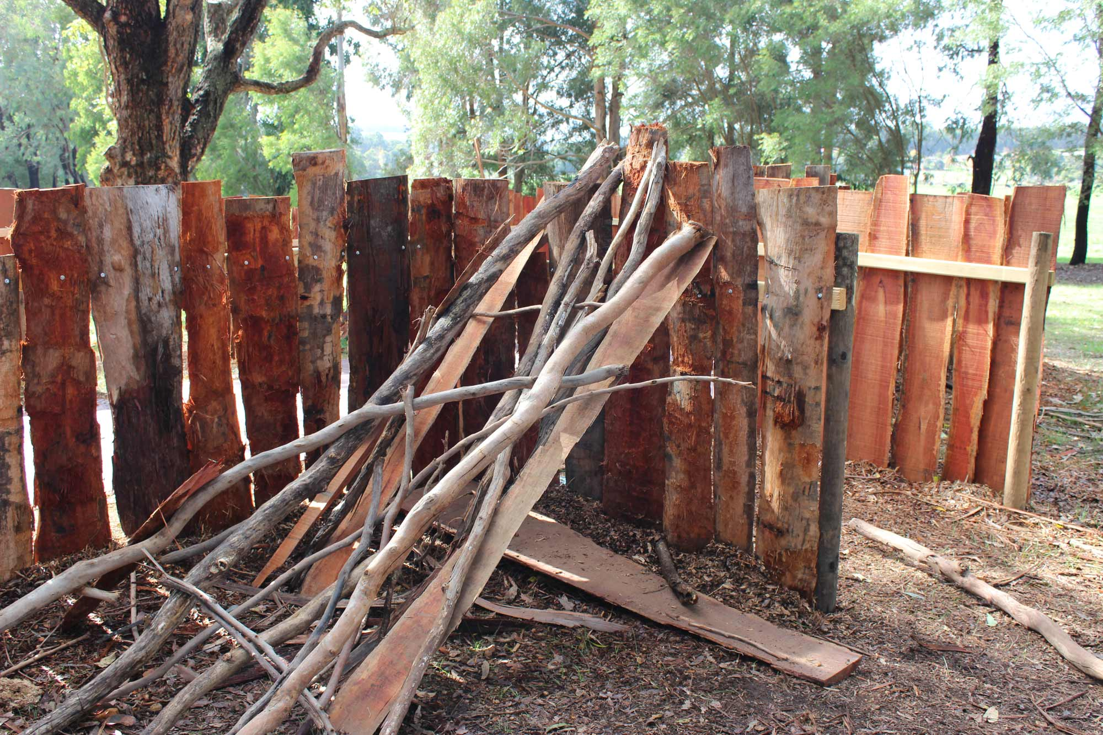
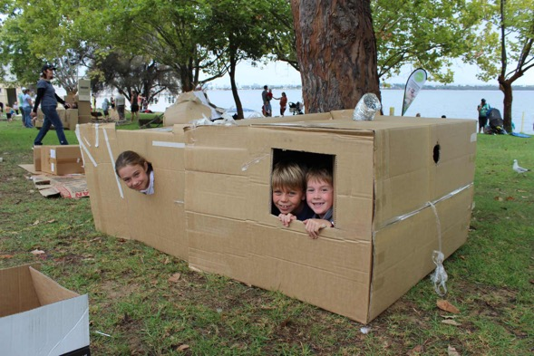

Changed the structure of school play spaces and insurance
Influence a family to build a cubby
Nature Play

Slide 29


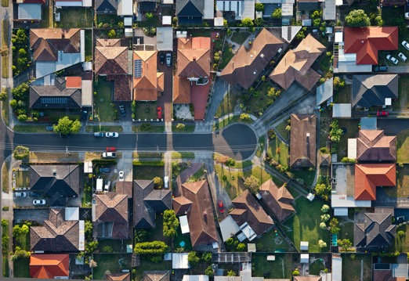
4. Organisations need to be able to be big and small
  EMERGING TRENDS

Slide 30

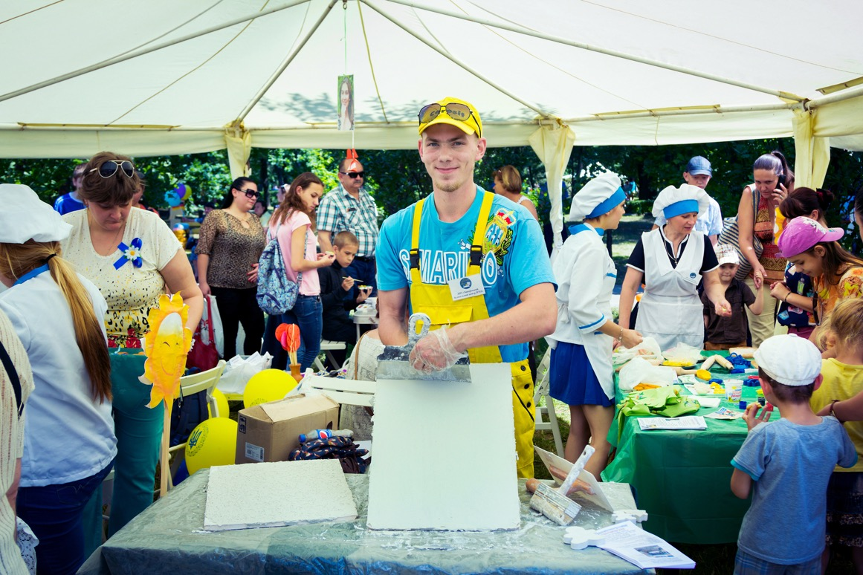
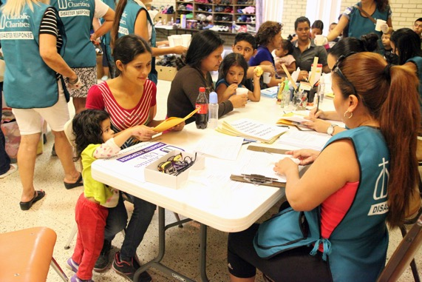
5. Civic mindedness grows in importance influencing buyers choices
  EMERGING TRENDS

Slide 31
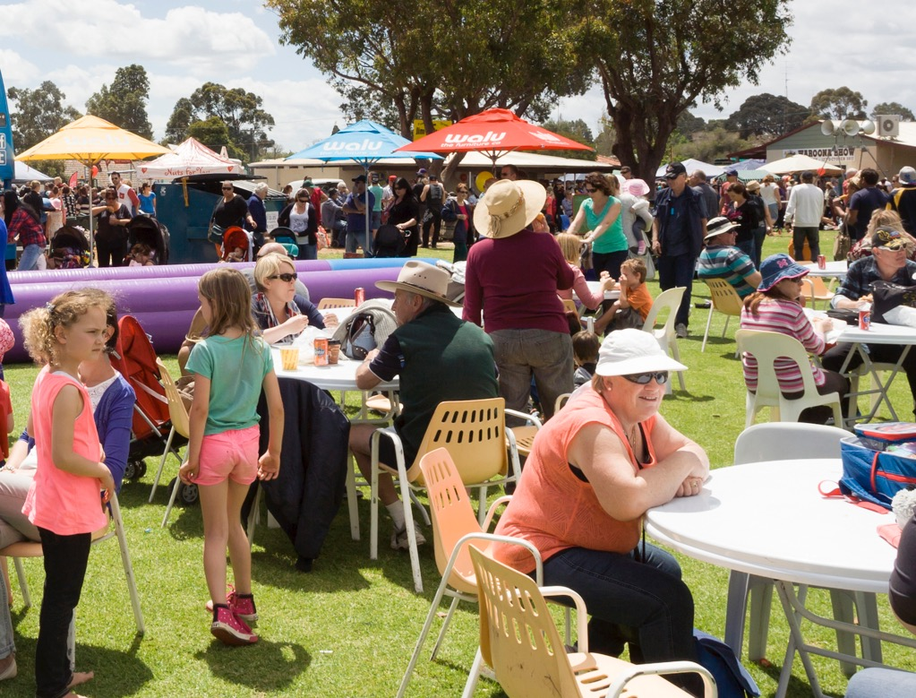


6. There is an emerging and growing “Community Movement”
  EMERGING TRENDS

Slide 32
INSIGHT
“ While people are seeking meaning, purpose and hope, they will be absorbed by the ‘cool’.”

Slide 33
Enterprise
Ageing in Place
  Town Centres
Civic / Retail
Community

Slide 34
Christ’s Ambassadors
What does this mean today?
Biblical Hints
Applications

Slide 35
