Slide 1
Midwives of Life and Liberation

Slide 2
shiphrah and puah

Slide 3
yocheveD

Slide 4
miriam

Slide 5
pharaoh’s daughter

Slide 6
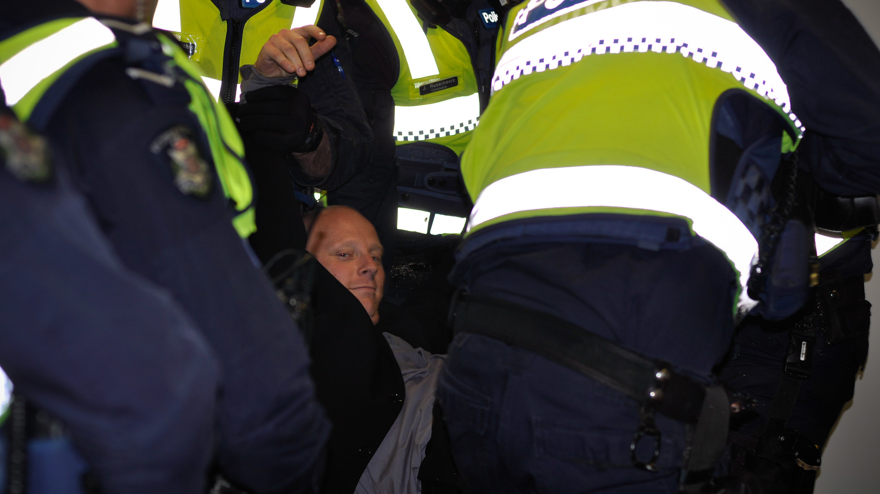
roles in HOLY CHANGEMAKING– the midwives
Calm and resolute in the face of injustice
Quietly defiant
Willing to do whatever is necessary to protect others
Taking risks
A healthy sense of the absurd

Slide 7
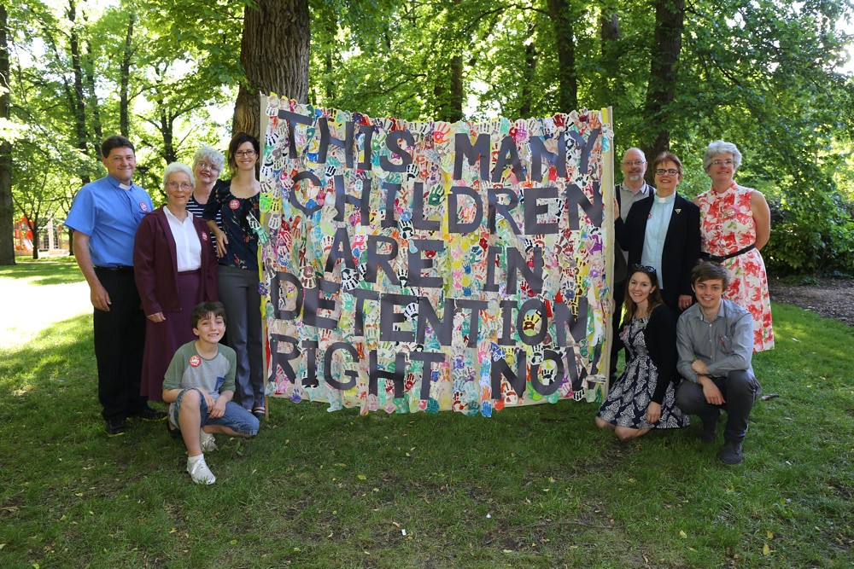
roles in HOLY CHANGEMAKING – yocheved
Quietly planning
Thinking several steps ahead
Avoiding attention

Slide 8
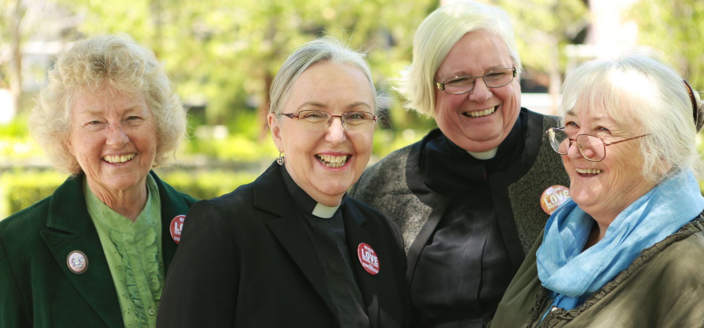
roles in HOLY CHANGEMAKING– miriam
Inviting people in
Encourages powerful people to defect
Making connections

Slide 9
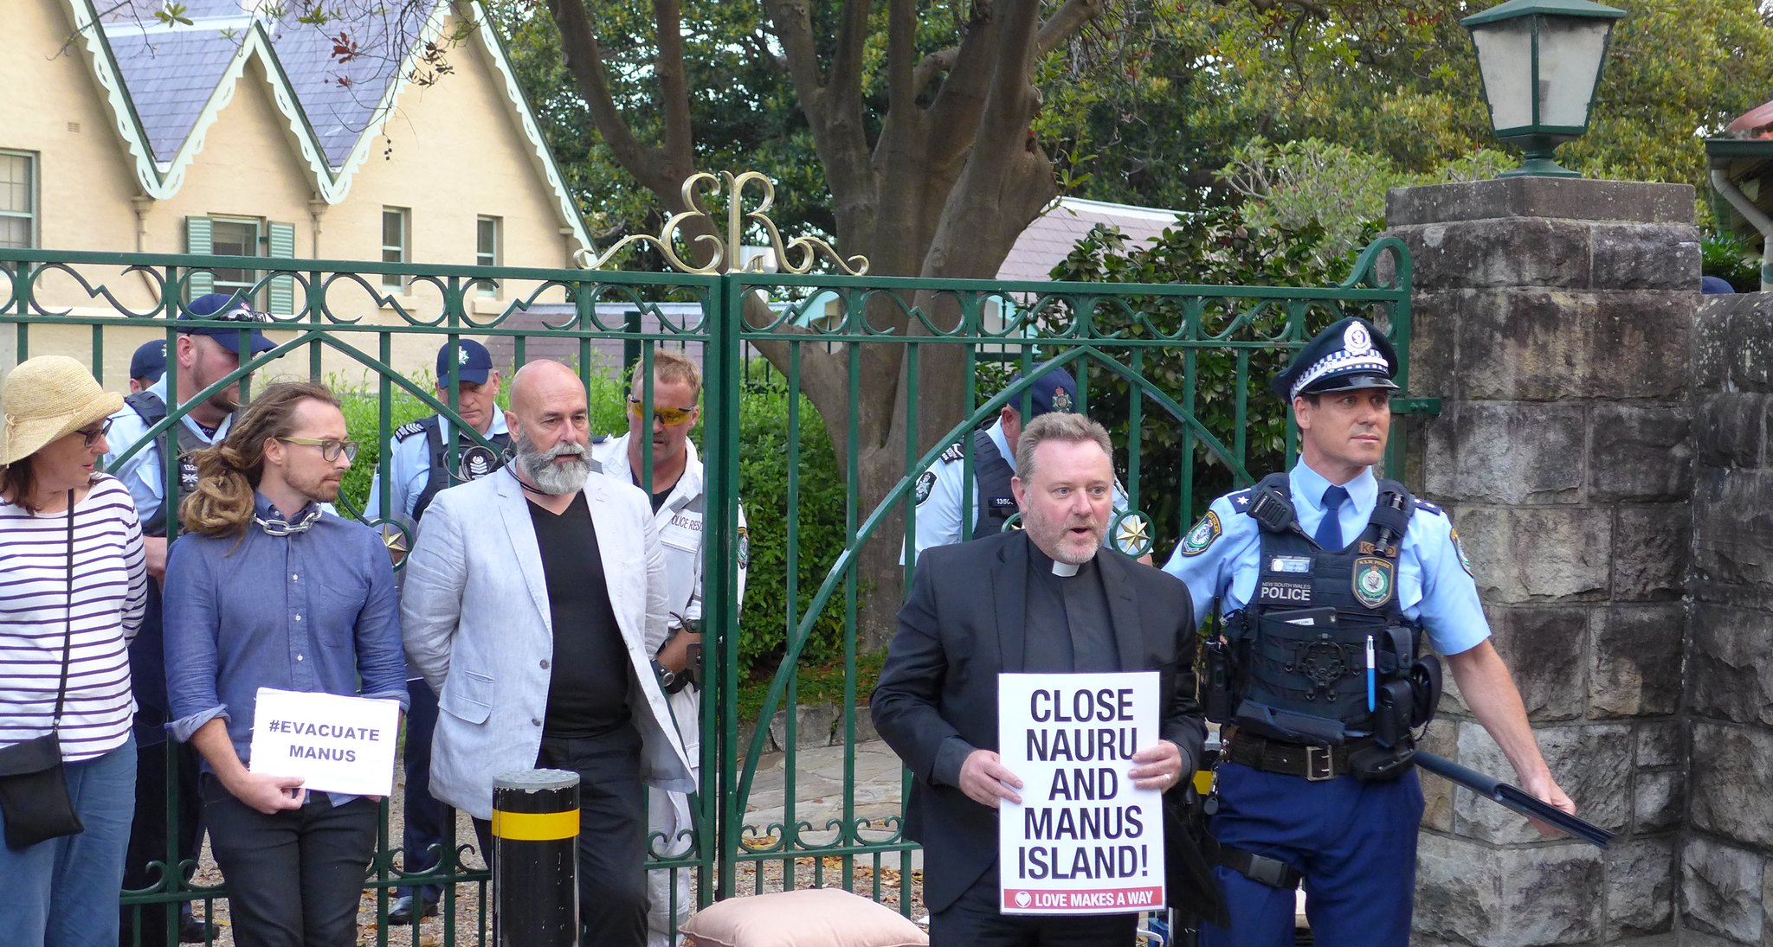
roles in HOLY CHANGEMAKING– pharaoh’s daughter
Using positions of power and influence
Prioritising those who are experiencing oppression
Keeping faith and solidarity

Slide 10
EVERY Christian has a role in holy changemaking
‘Some march with events
to turn them God’s way;
some need to withdraw
the better to pray;
some carry the gospel
through fire and through flood -
the world is their parish,
their purpose is God’

Slide 11
my current work in holy changemaking

Slide 12
WHY DO FAITH WORKERS NEED A UNION?

Slide 13
WHY DO FAITH WORKERS NEED A UNION?

Slide 14
support represent empower

Slide 15
Midwives of Life and Liberation
Learning from the earliest recorded instances of civil disobedience

