Slide 1
Building Capacity,
Building Community
… one piece of wood at a time…
Sustainability, creativity, and social engagement.
Greg Miller The Joy of Wood 2021

Slide 2
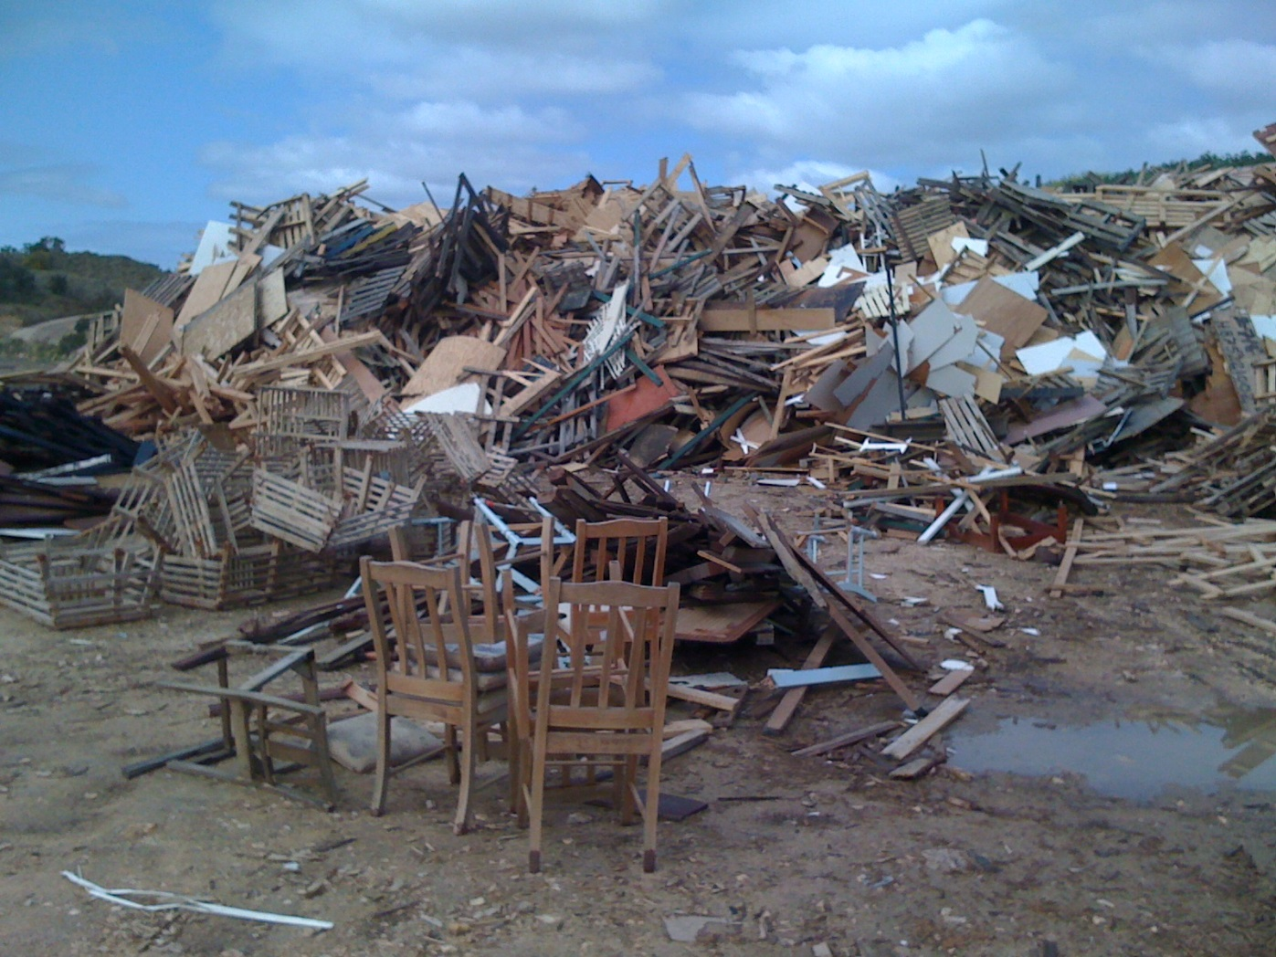
The Planet is hurting.
So are the people.
It’s time for us to re-connect.
With both.
The Fundamental Premise

Slide 3
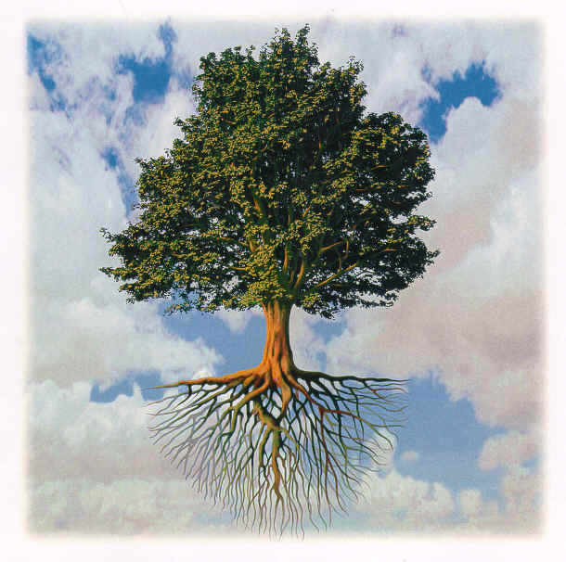
A quick word about trees and wood.
Image Source:
www.wisdom.weizmann.ac.il/~oweimann/TED/tree.jpg

Slide 4

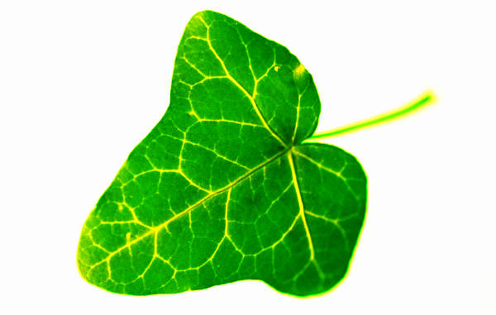
Carbon Sequestration
CO2
O2
Solar Energy
H2O
vapour
Photosynthesis
Carbon
in the form of lignin, cellulose + extractives
Sugars
(Food for the tree)
H2O
Carbon is sequestered in wood all around you!
+ nutrients
Carbon locked up in wood

Slide 5

The Value and Wonder of Trees & Timber
Source of food and shelter for humanity.
Conversion of CO2 to O2.
Carbon sequestration.
Recyclable and re-useable.
Renewable organic resource.
Low energy natural building material.
WOOD - a gift from the trees.
ImageSource: Clker.com

Slide 6
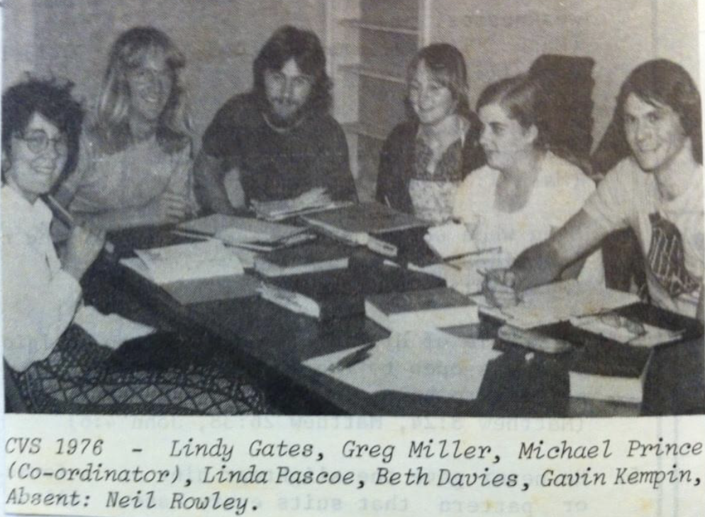

One meandering journey, Two Key Threads:
1. Working with People

Slide 7
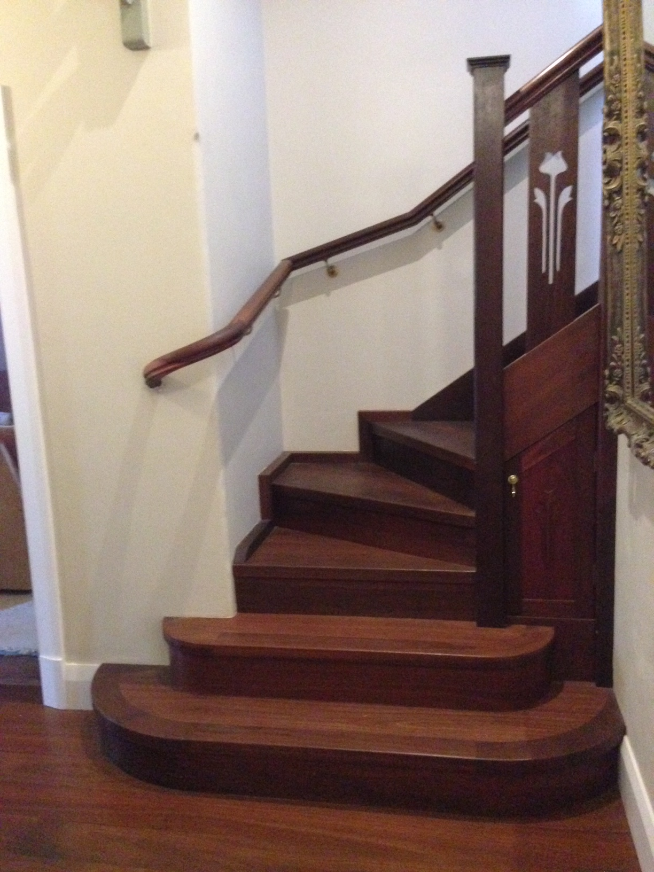
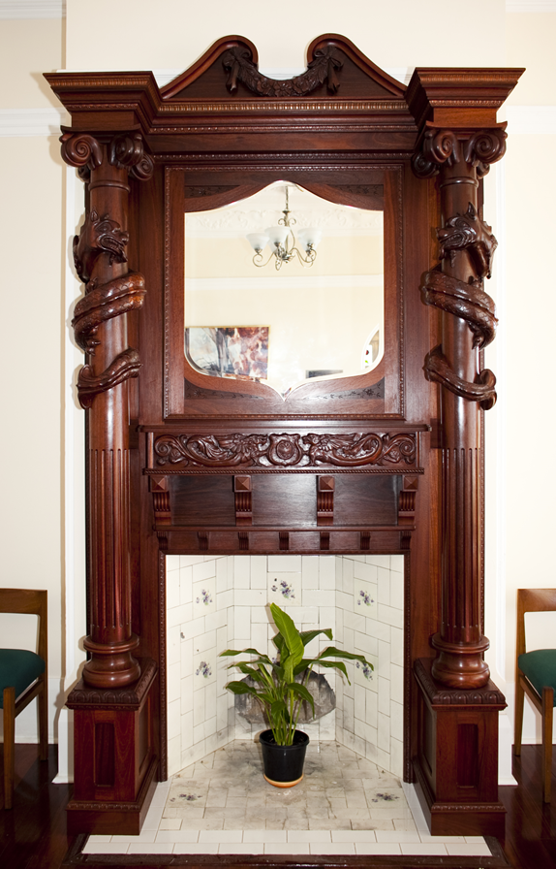
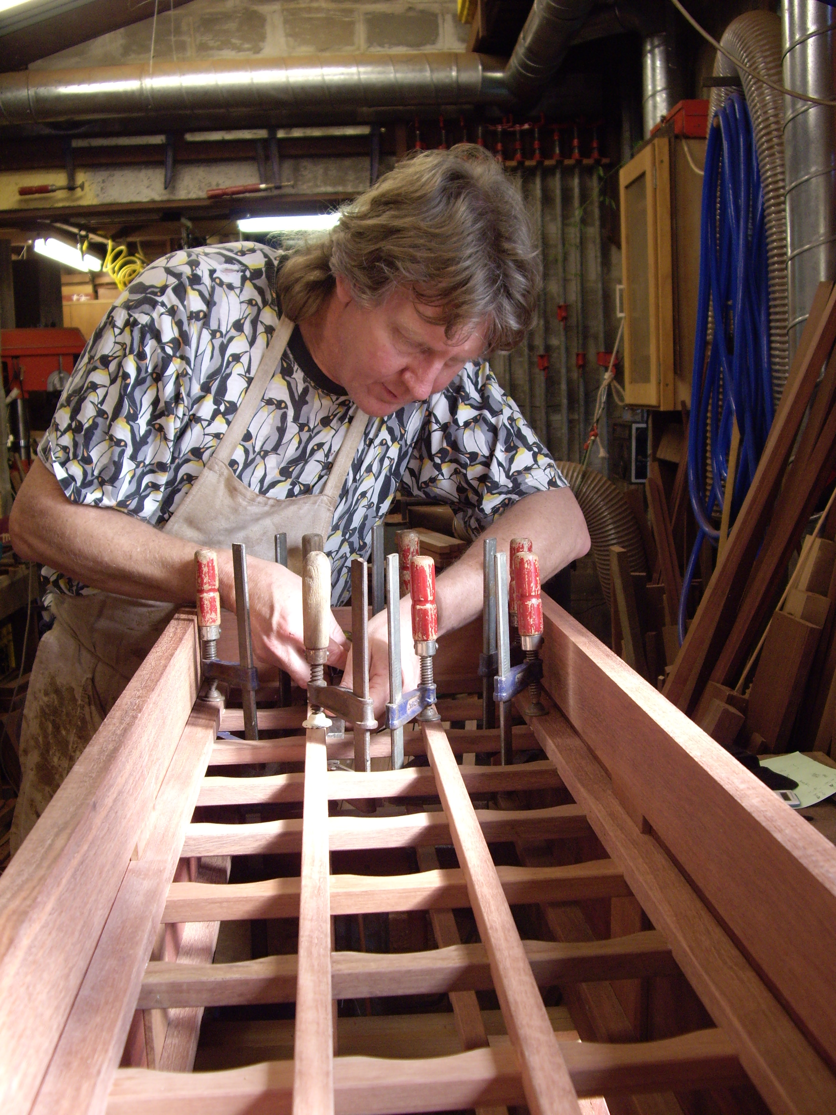
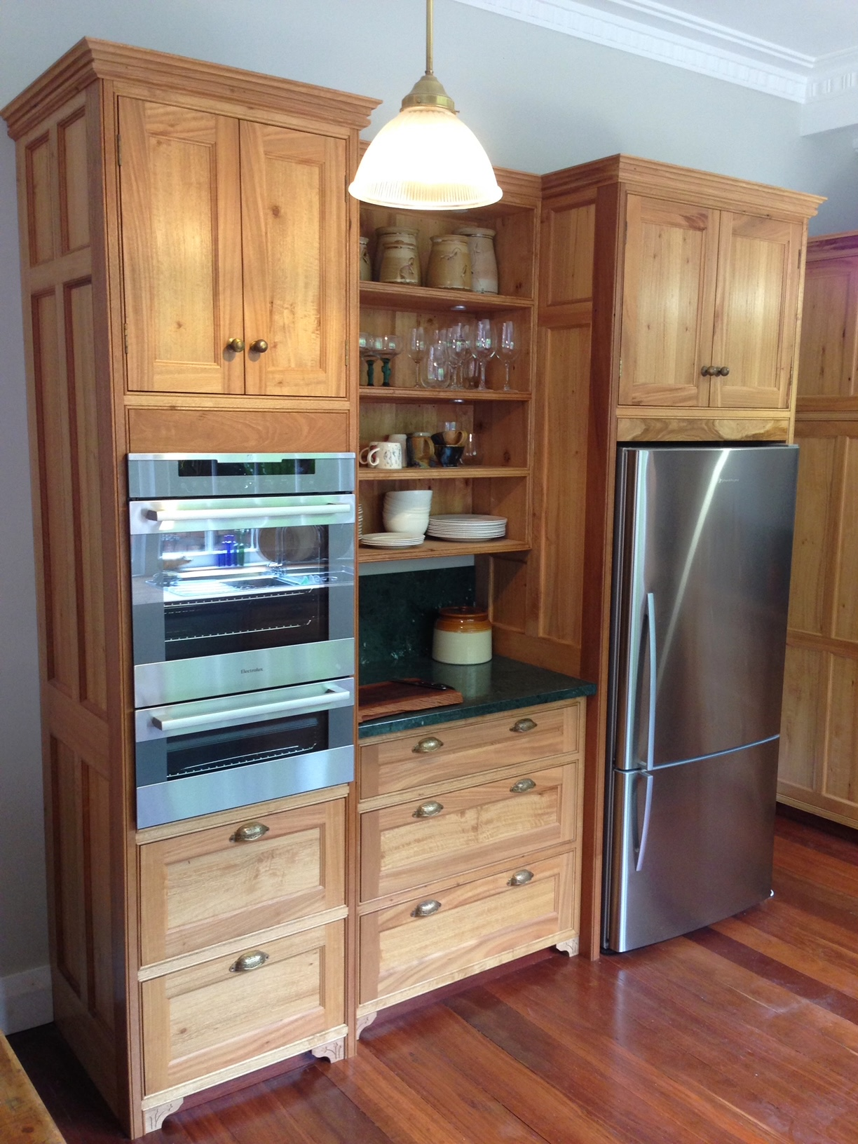
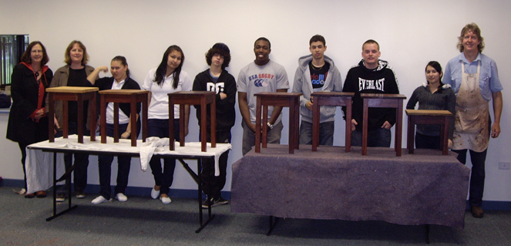
One meandering journey, Two Key Threads:
2. Working with Wood

Slide 8


An idea evolves…
From 2009, while running a Cabinetmaking/Joinery business, I was running mobile workshops with people in various settings, mostly in the area of wood recycling, alternative learning programs, and teaching traditional hand skills.
Formative overseas trips along the way:
2010 Visit to several woodworking projects with disadvantaged youth in Washington DC.
Visit to 9 different Community Wood Recycling Projects in the UK.
2013 2 months in the USA learning traditional skills – my “Green Woodworking Odyssey”.
2015 Opportunity to use some unused warehouse space create a set up teaching space for the Joy of Wood.
The Heritage Woodcraft Centre was born…

Slide 9
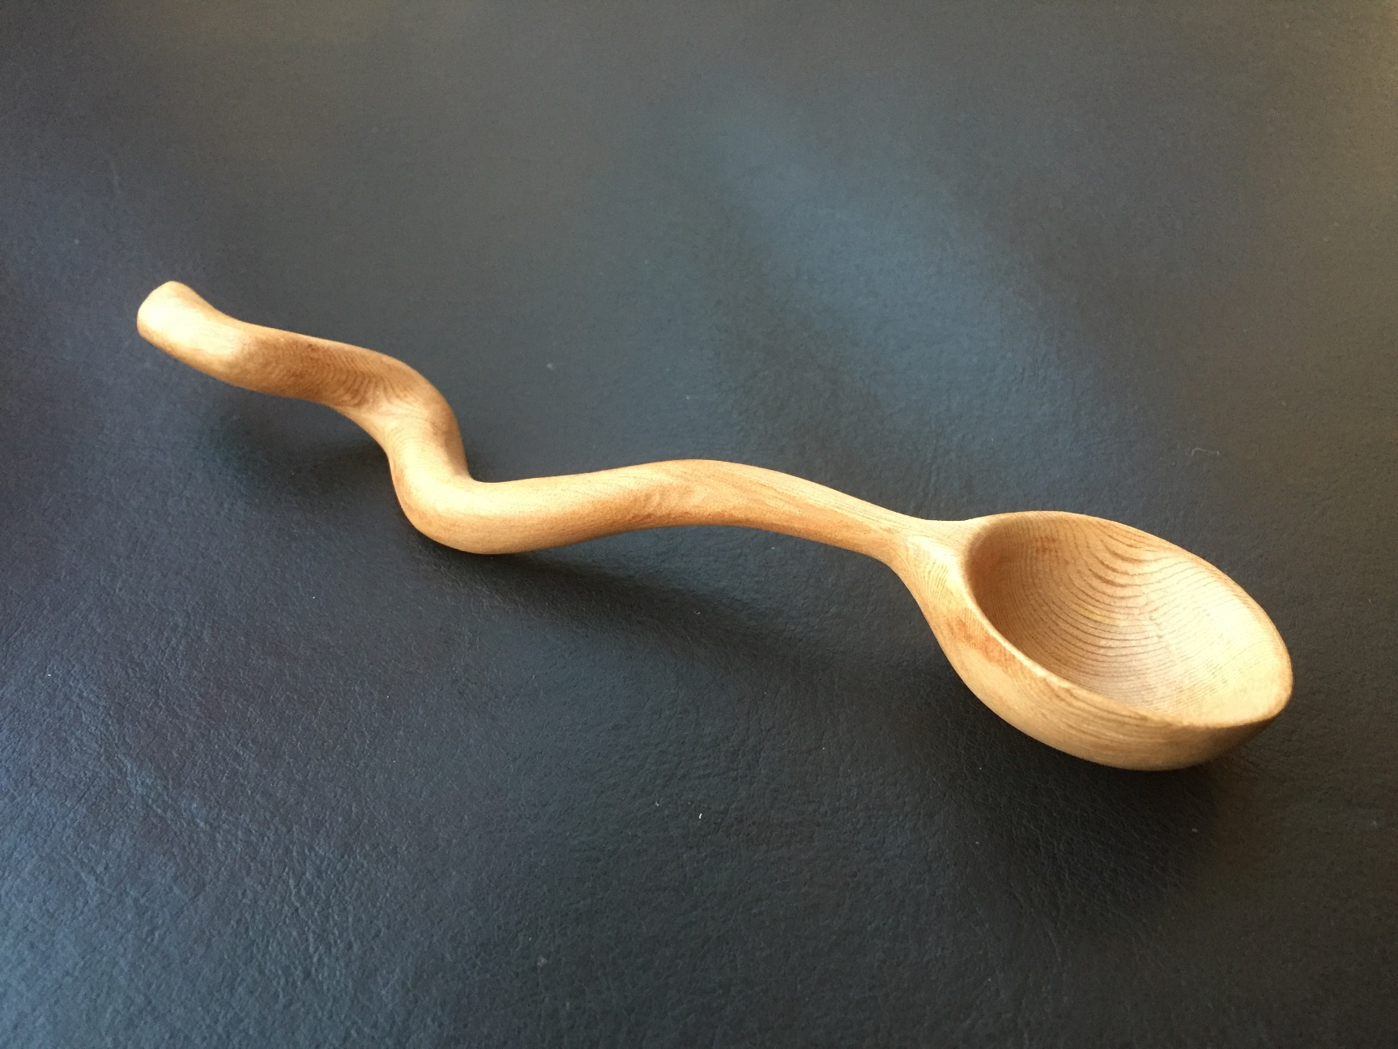
The Fundamental Need to be Creative
People are inherently creative.
The need to be creative runs at the core of our humanity.
We see that natural creativity being expressed easily by children.
In the modern world, we can lose touch with that fundamental inner need.
The resurgence of interest in traditional crafts reflects the desire for social and therapeutic value of expressing creativity together.

Slide 10
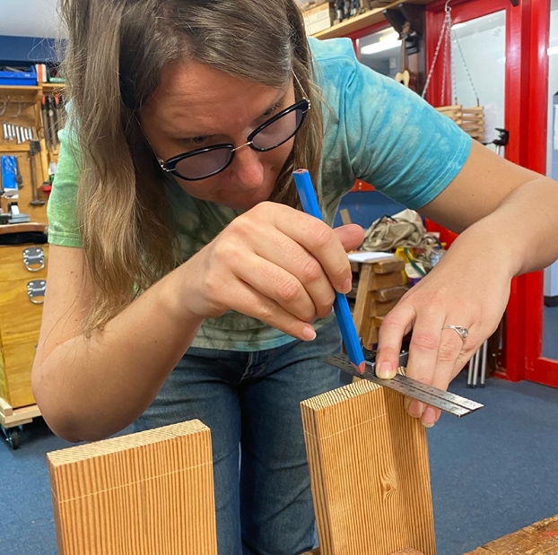
The benefits of using our hands.
Hand tool woodworking:
Sensual experience.
Strong connection between our hands and our brain.
Body awareness.
Hand-to-eye coordination.
Spatial relations.
Sense of empowerment.
Low carbon activity.
Environmentally sustainable.

Slide 11
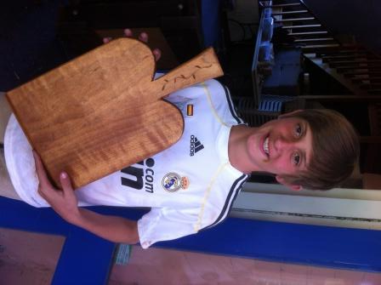
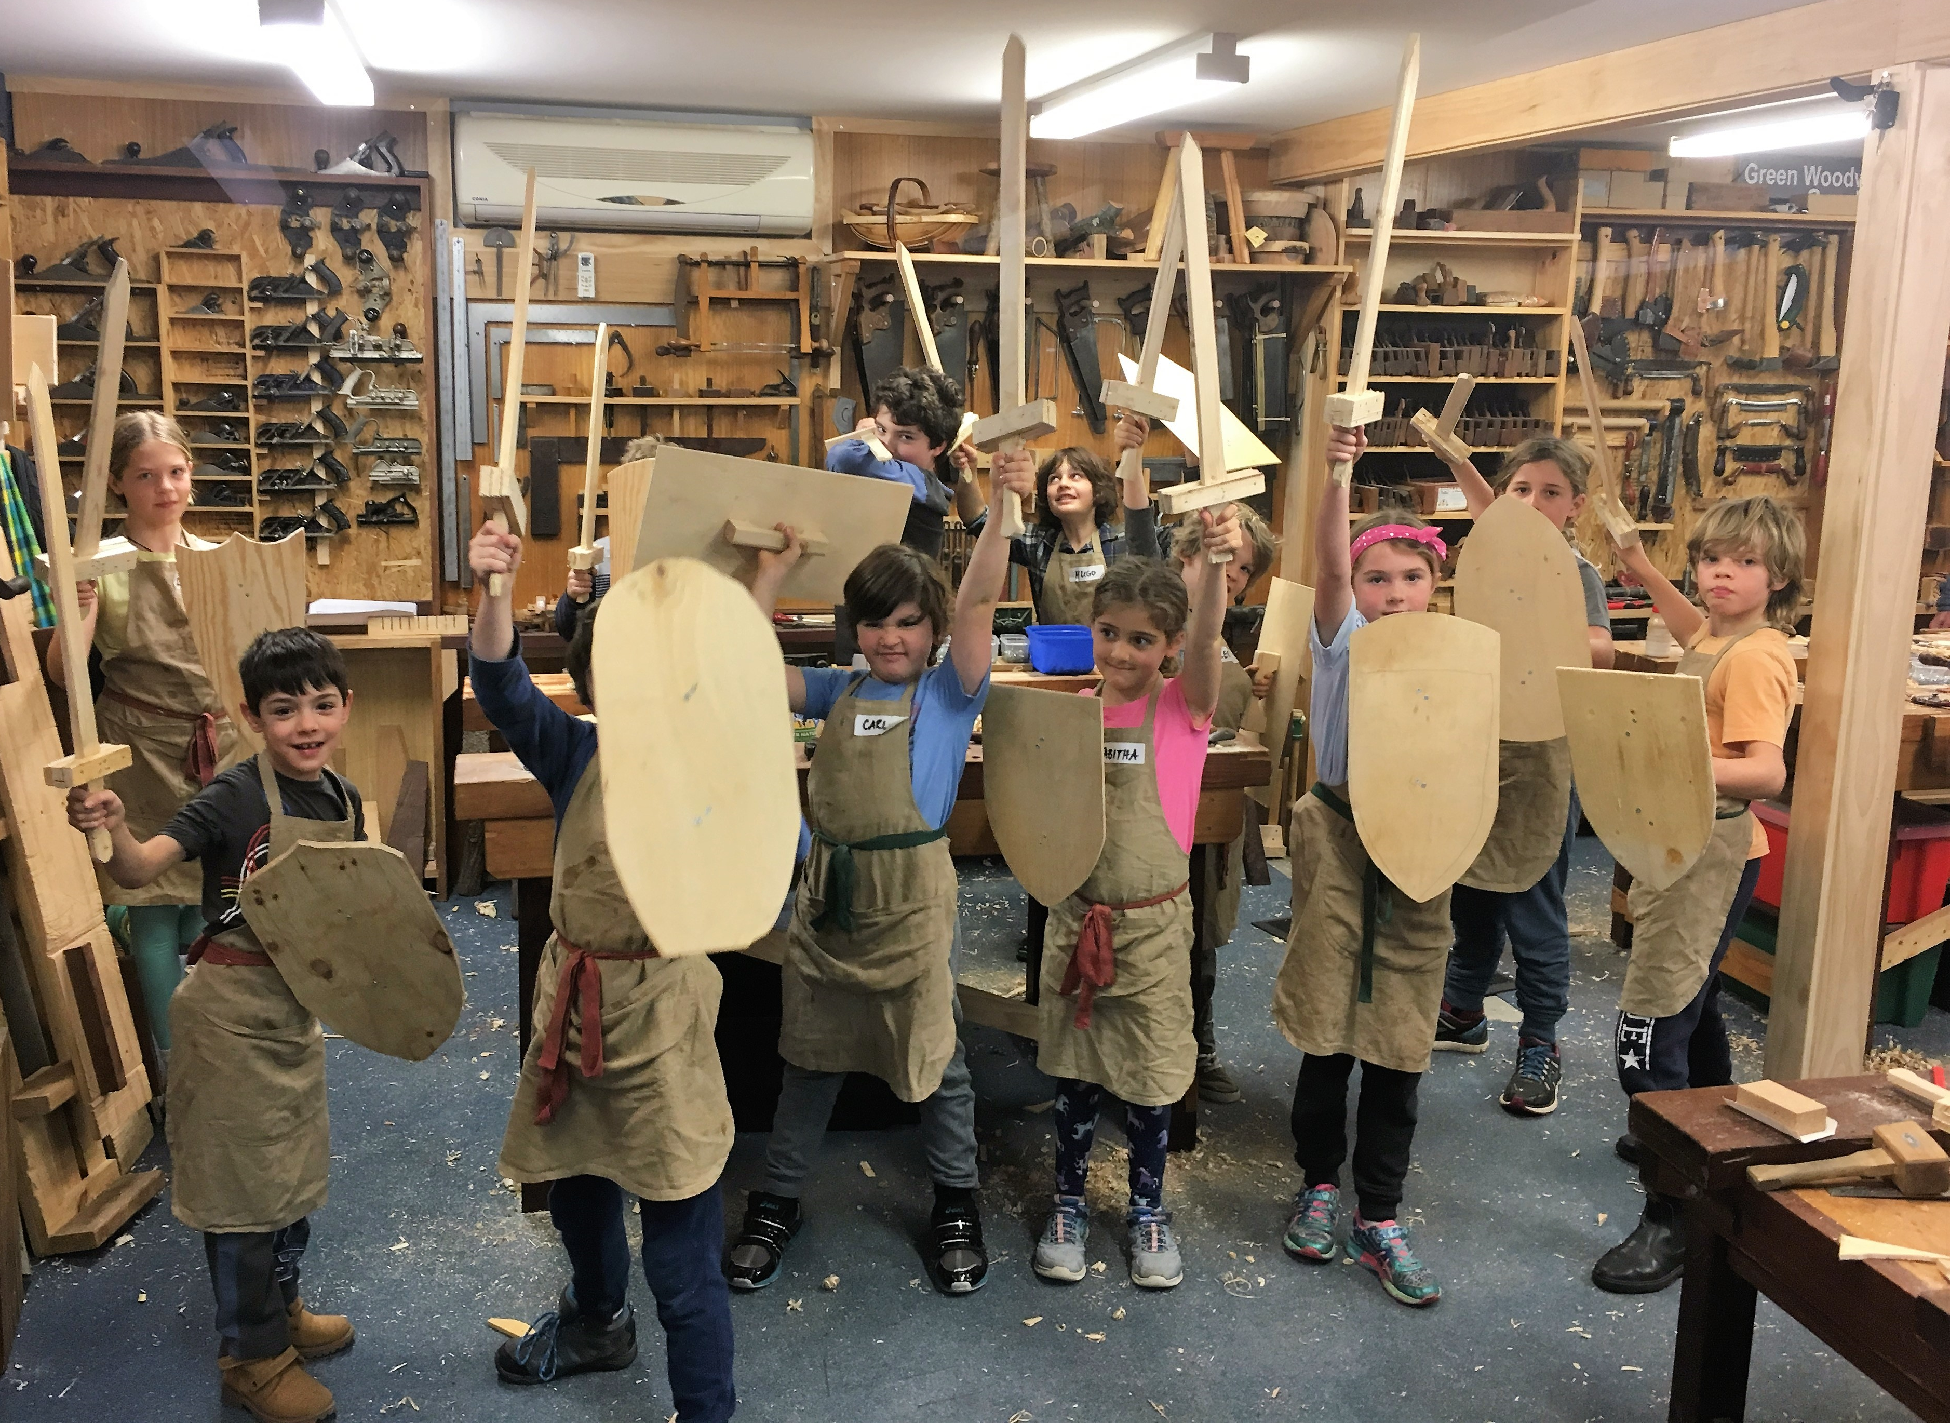
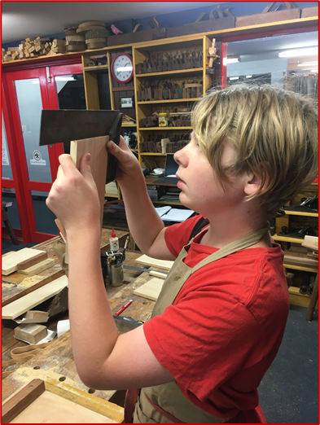
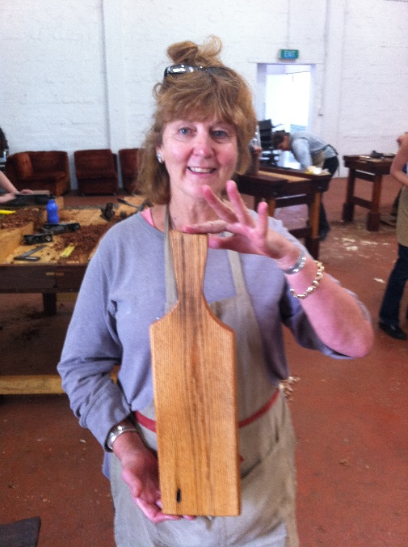
Experiencing the Magic of Making, together.
It builds self-confidence and a sense of empowerment.
It builds community – connections between people.
It builds respect for trees and for timber.
It helps build resilience.
It encourages thinking and action regarding sustainable living.

Slide 12
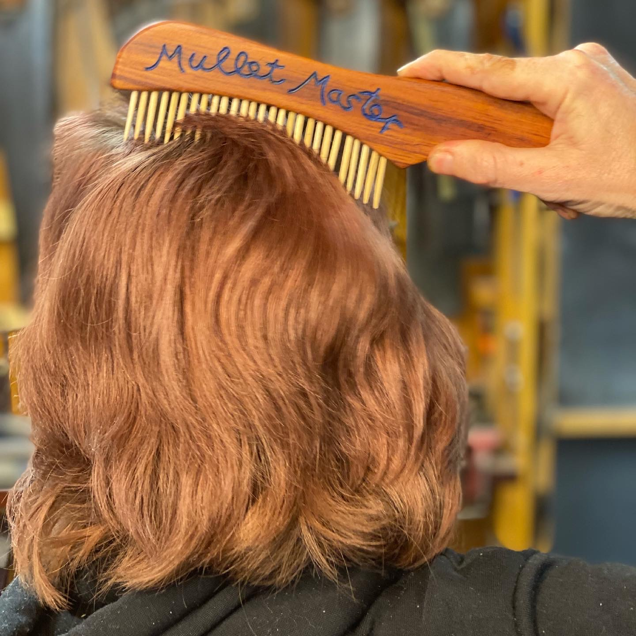
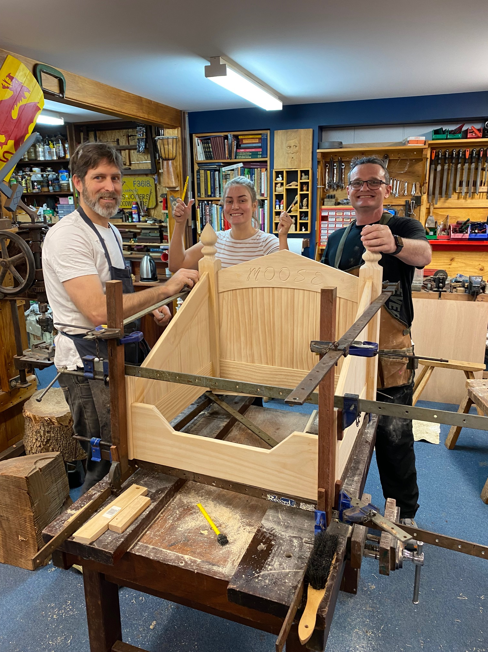
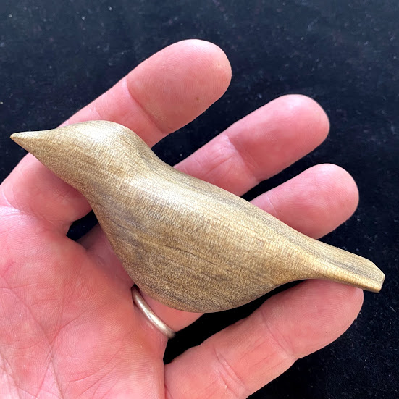
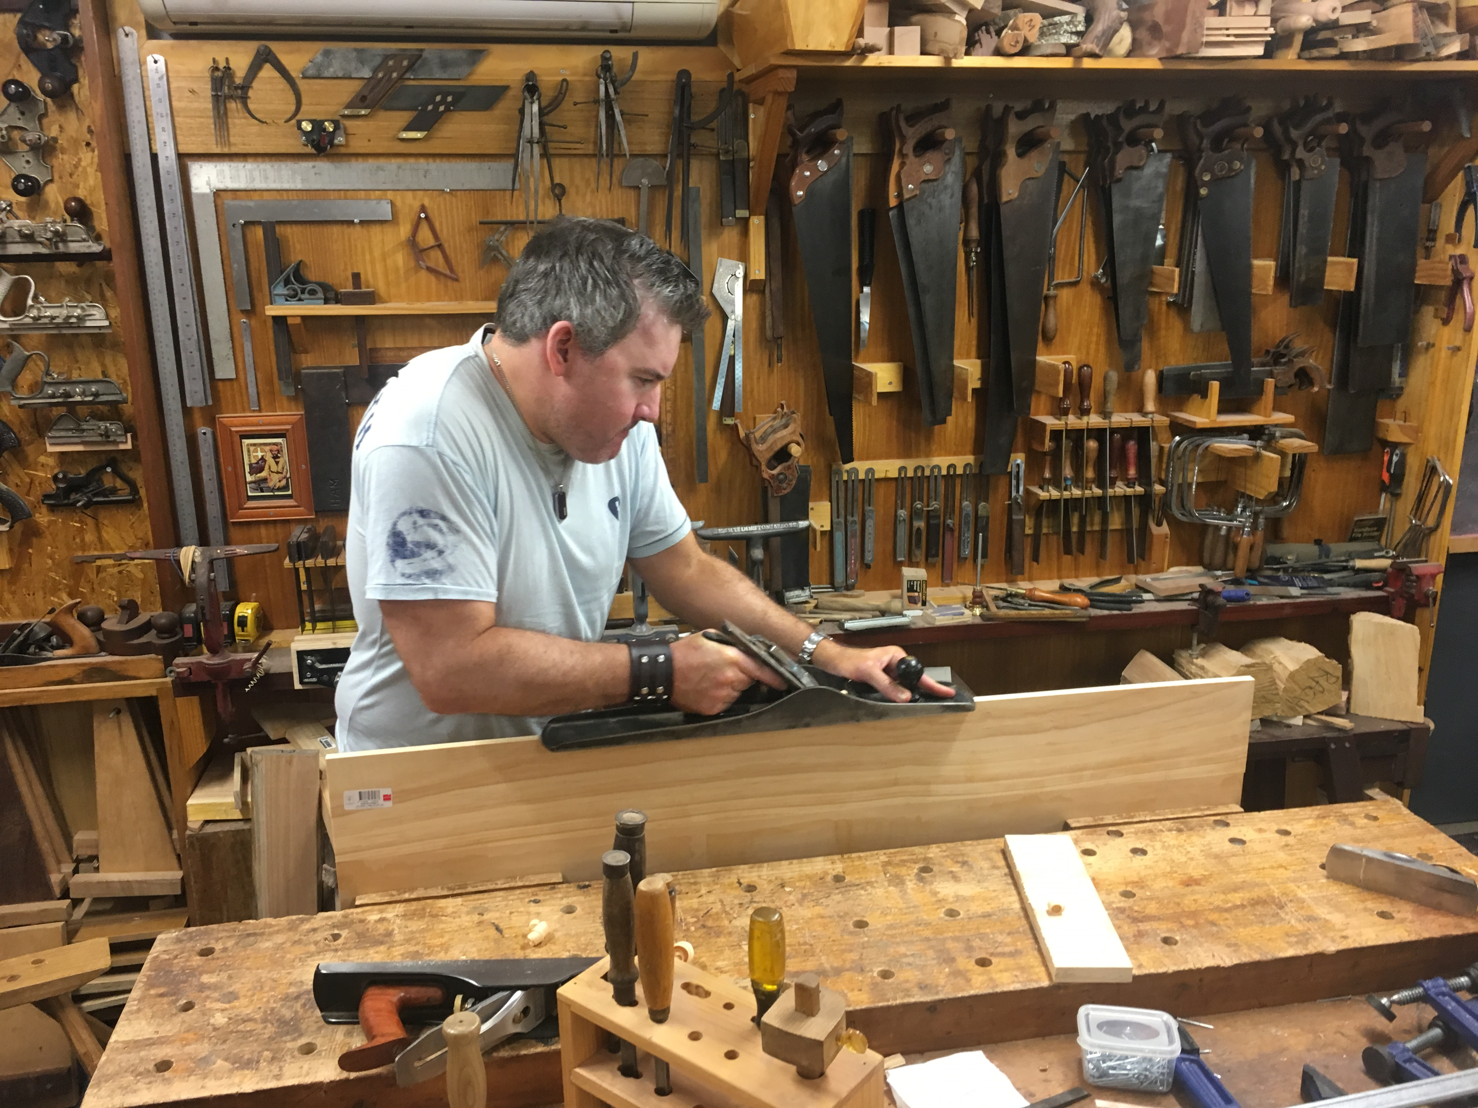
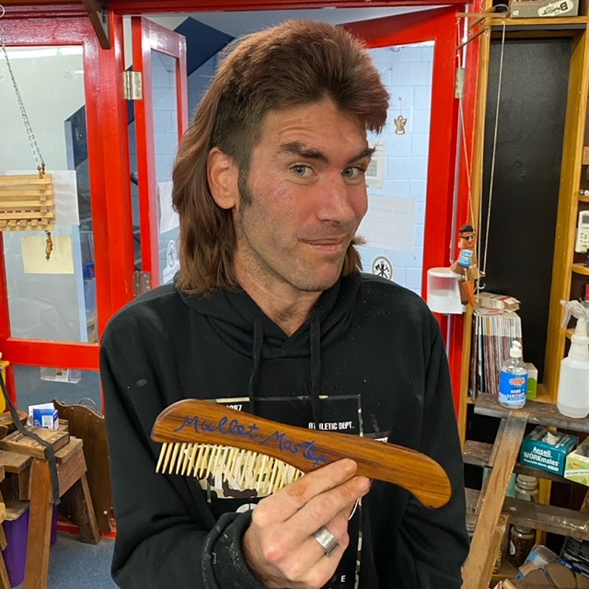
Therapeutic Woodworking

Slide 13
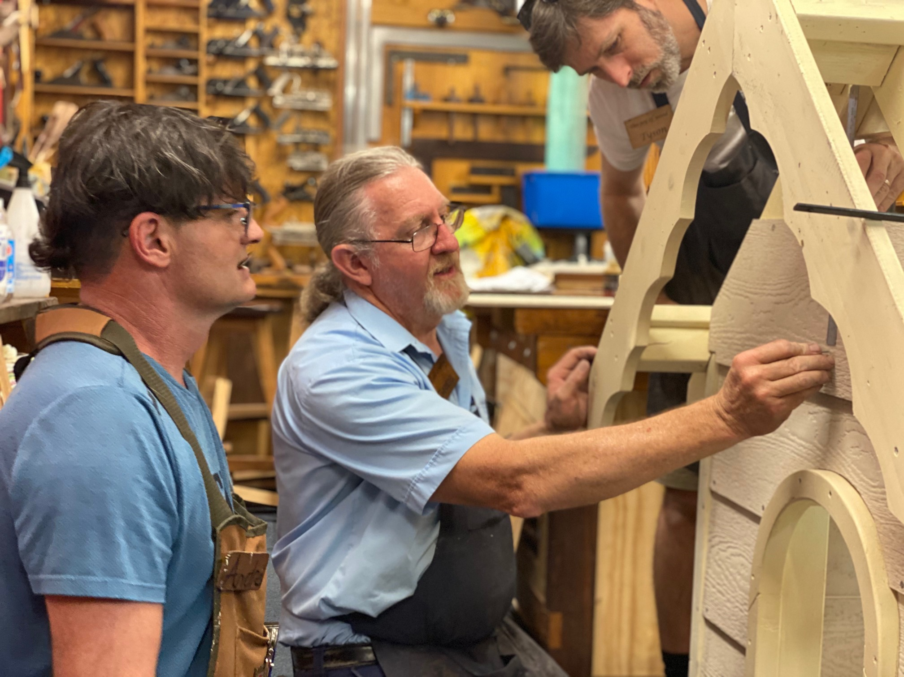
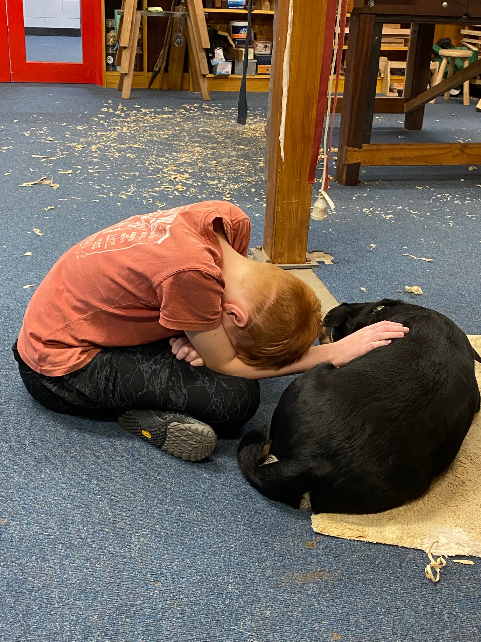
Creating a Safe Space

Slide 14
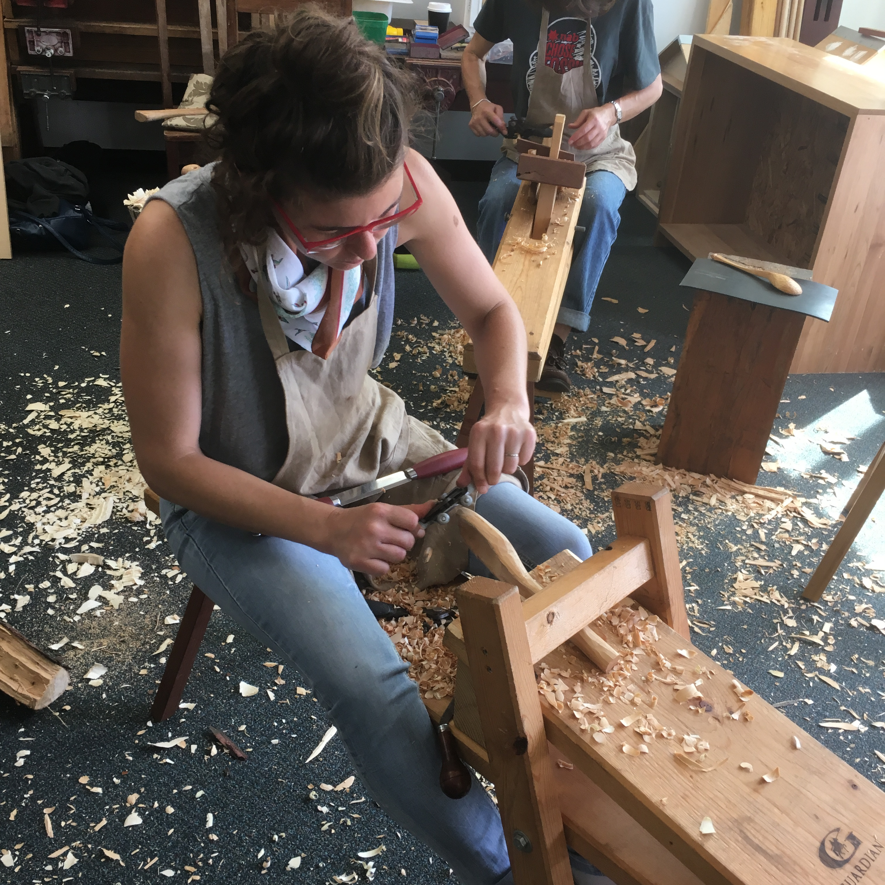
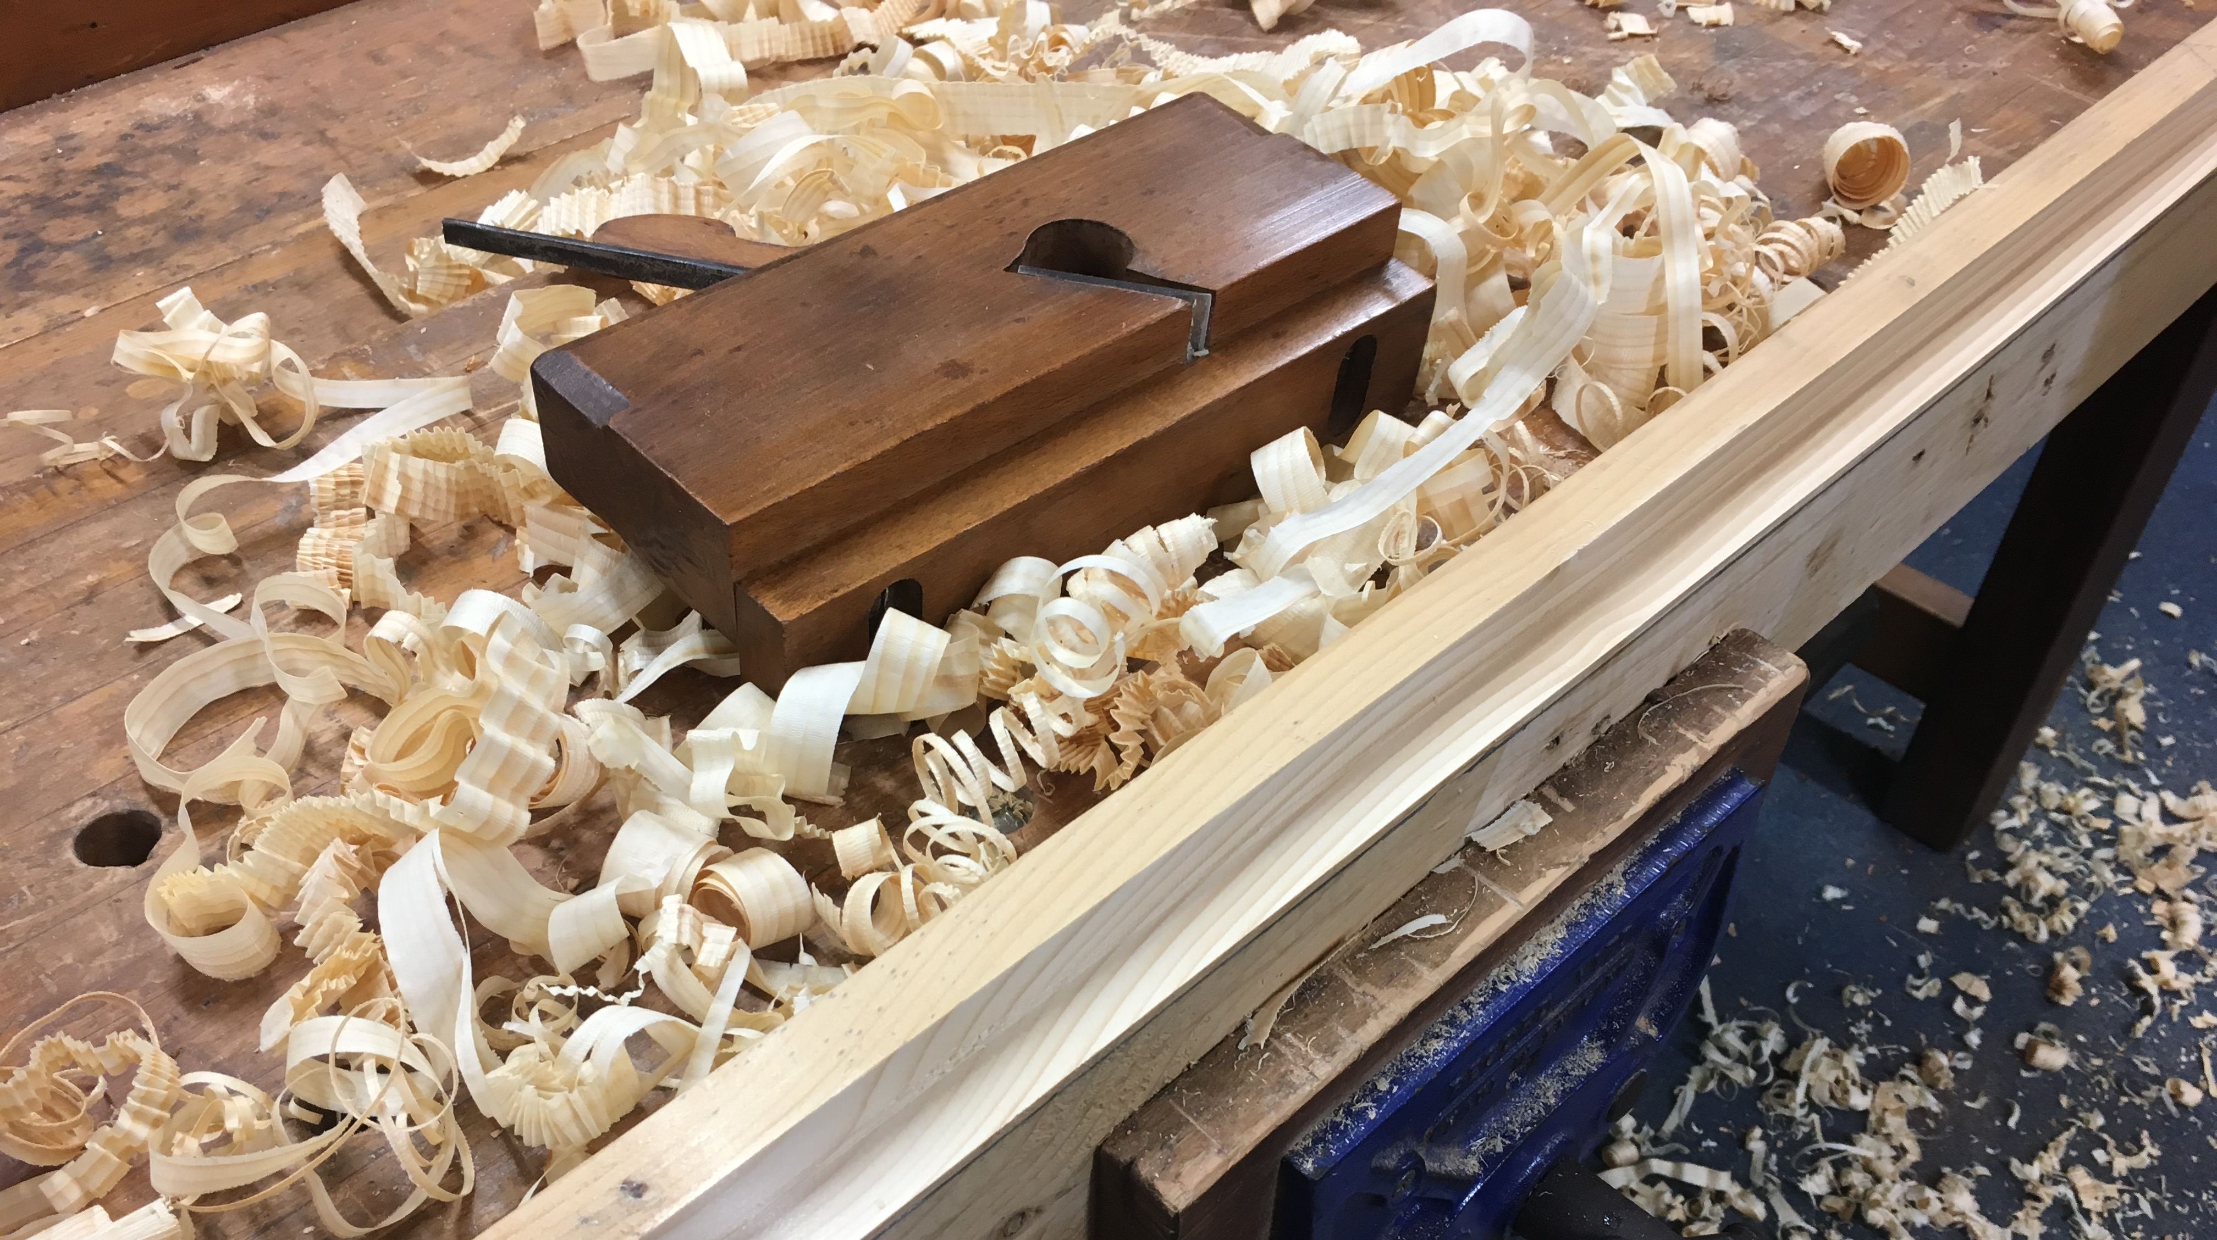
Reclaiming traditional skills
We have lost the skill and ability to fix things, so we discard the old and buy a new one.
Basic and traditional skills are being lost, and are no longer being passed on to our kids.
Timber can be recycled almost indefinitely, so traditional tool skills and knowledge combined with a commitment to recycling and re-use of timber will help reduce the waste.
The evolution of tools and techniques reflects our changing social history.

Slide 15
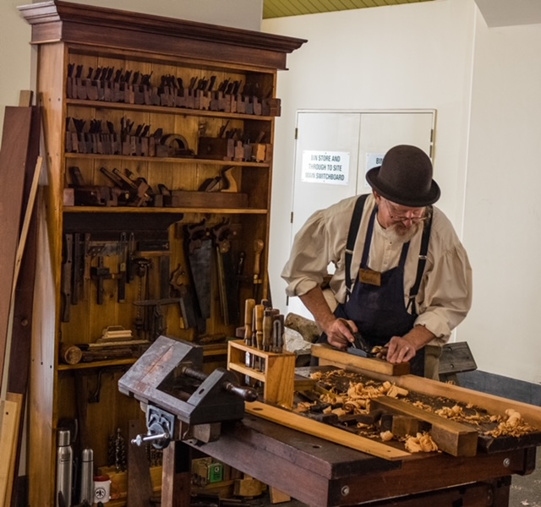



Our scope of activities are evolving…
School incursions X
Festival woodworking activities for kids and families
Public workshops …….
Private workshops, eg Homeschoolers and family groups ……
Heritage demonstrations and interactive displays.
On-line shops.
Private tuition:
  Skills development ……
  Therapeutic woodworking
Volunteers and seekers of community

Slide 16
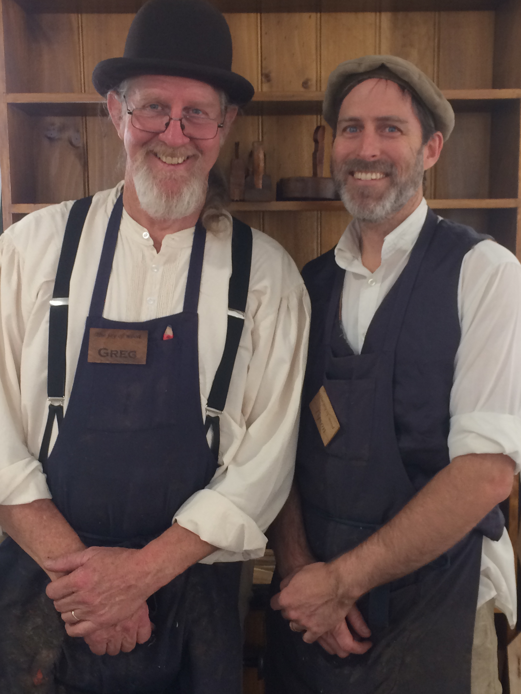
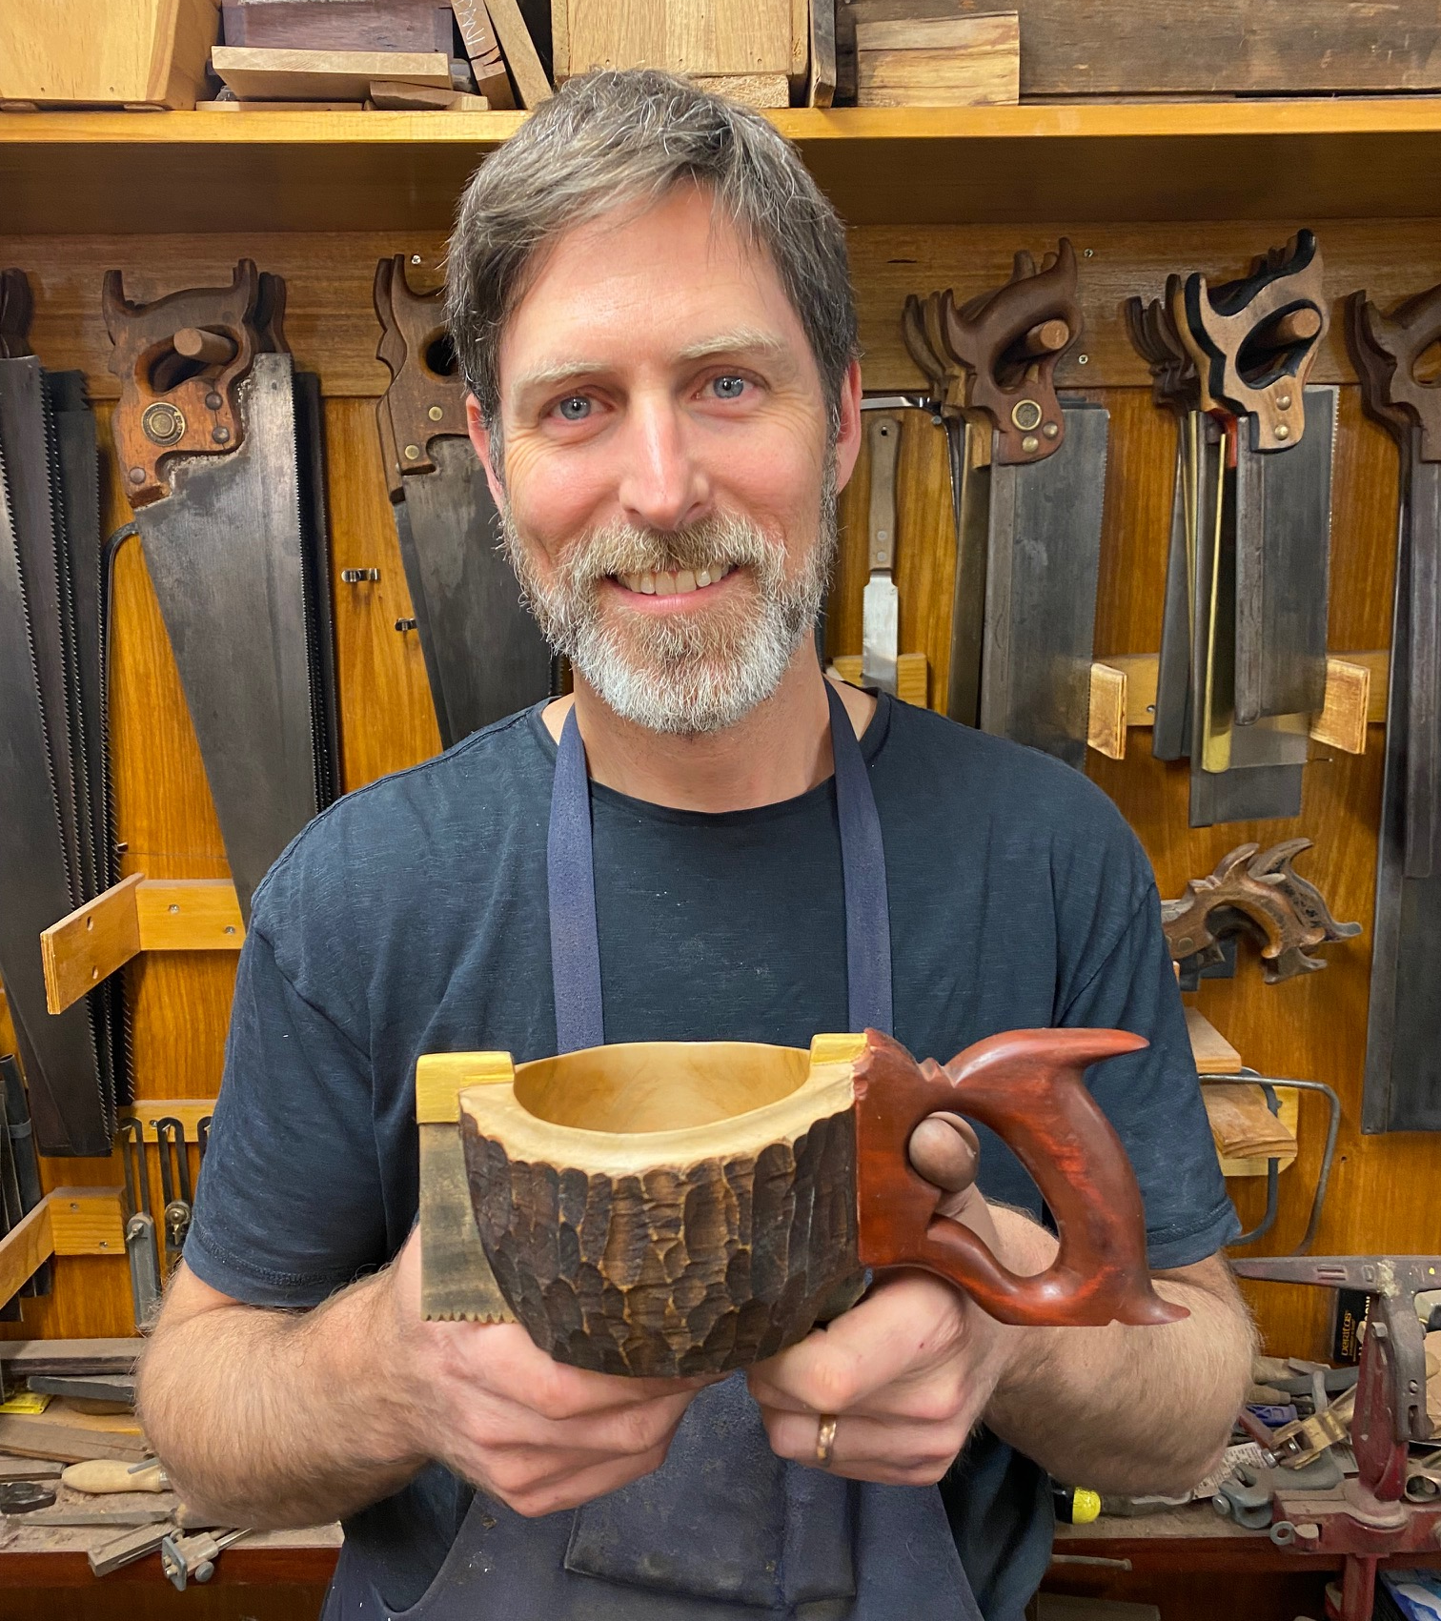
It’s about the people…

Slide 17
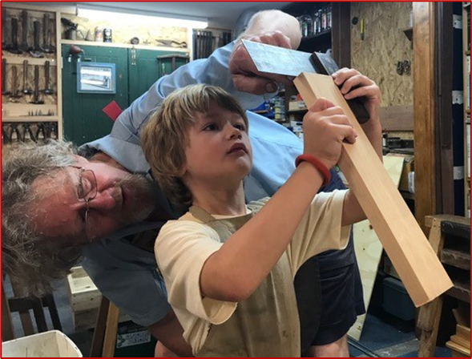
www.thejoyofwood.com.au
Building Capacity
Encouraging sustainability
Encouraging creativity
Valuing history
Re-building lives
Facilitating social engagement
… one piece of wood at a time…

Slide 18
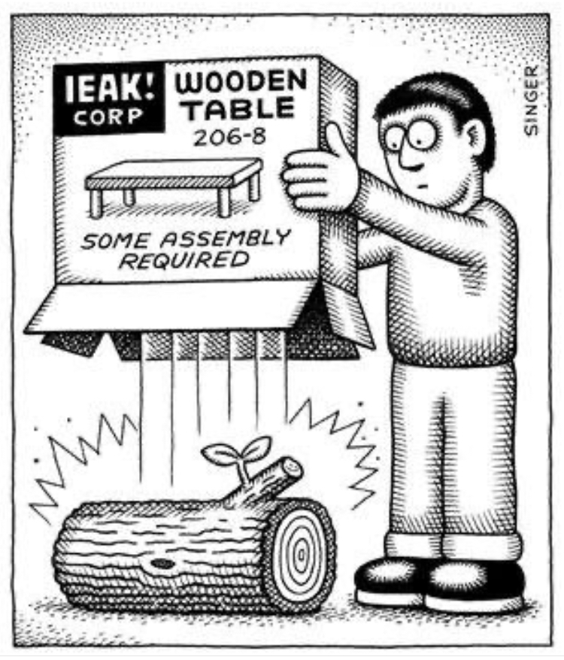

Slide 19
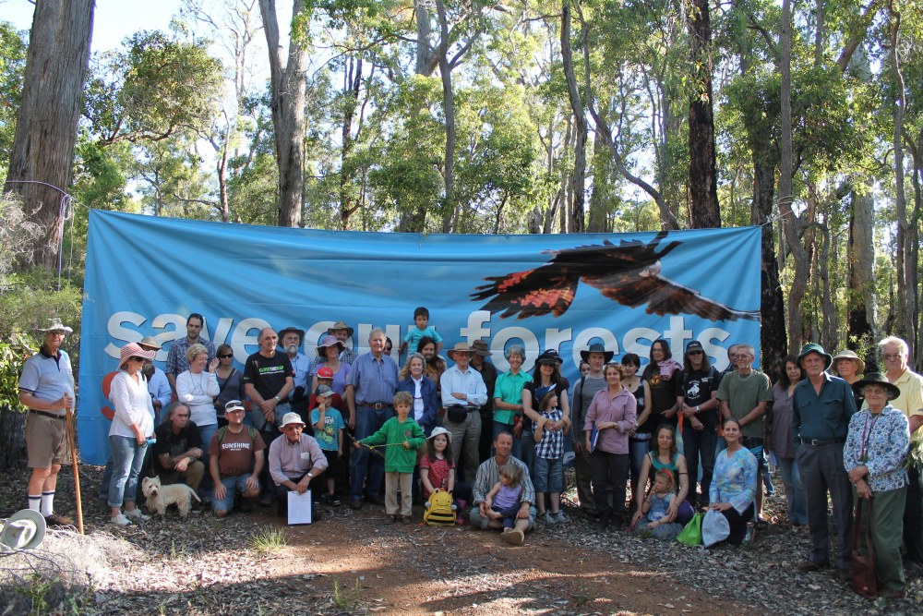
Many people are passionate about standing up for the remaining Jarrah forest…
www.indymedia.org.au

Slide 20
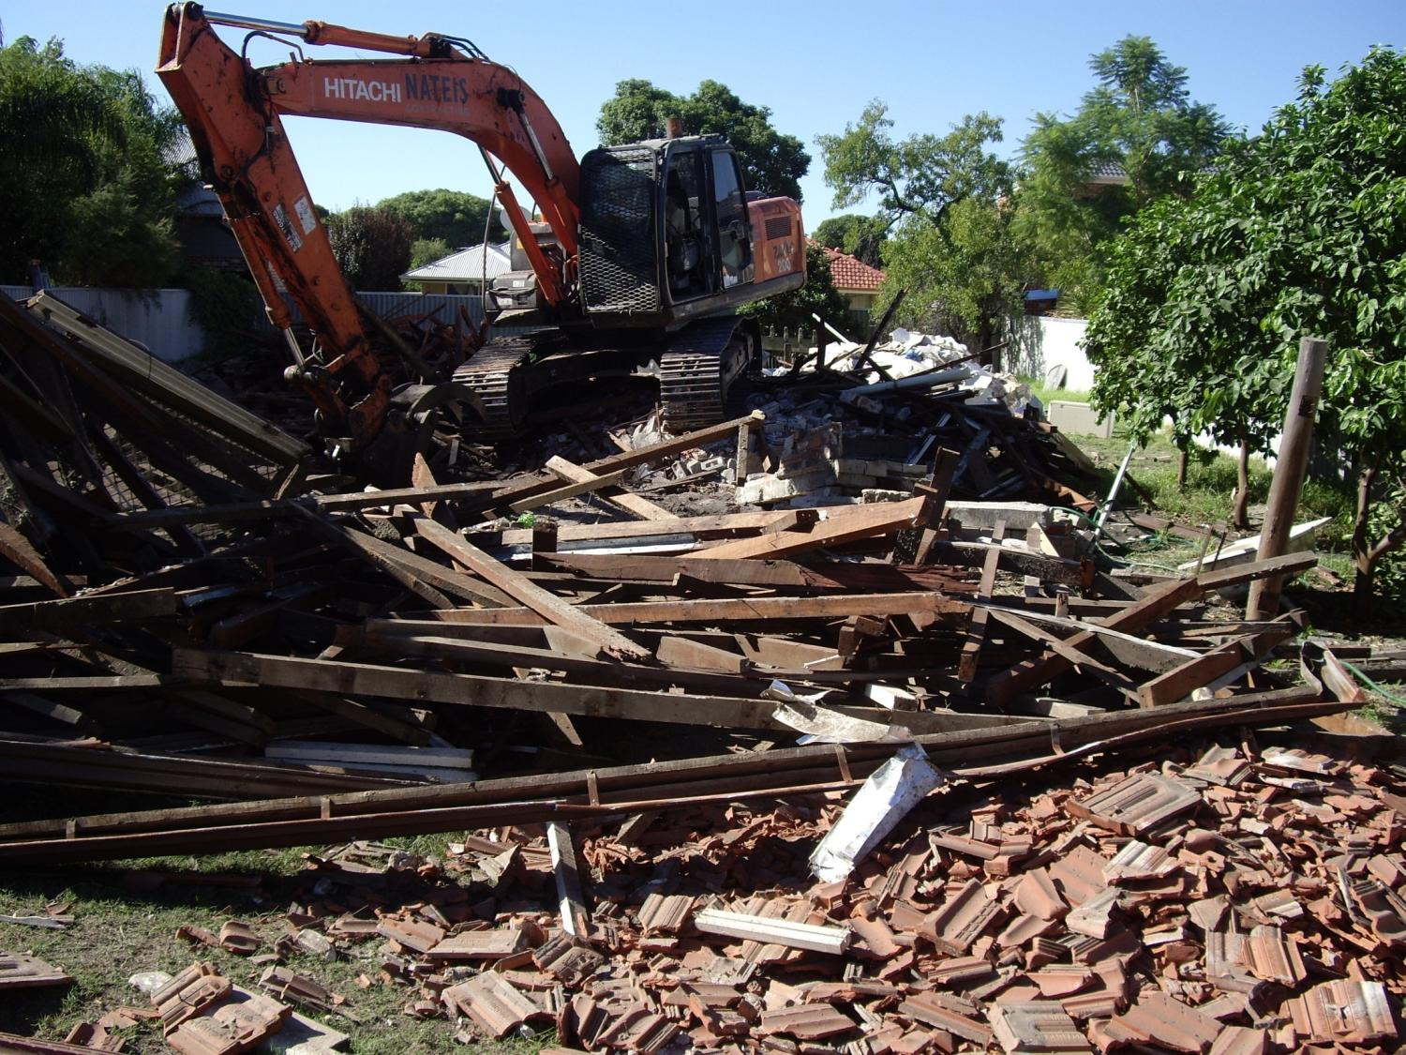
… but who is standing up for the trees which have already been felled over the last 180 years?
As every day in Perth huge quantities of jarrah are being dumped into landfill…

Slide 21
Eco-woodworking:
Environmentally Responsible Woodworking
Be thoughtful about the timber you use. Give respect to the trees from whom the timber came in the frst place!
Recycle/re-use timber as much as possible, or consider using timber from certified sustainable sources.
Working wood requires some tools. Hand tools require no electrical power. You supply the muscle.
It requires some skill. The skills can be learned by anyone. Traditional hand skills have developed over centuries.
The best hand tools are often the old traditional ones. Made to last and of good quality steel. These are not disposable!
Use finishes which are friendly to the planet!

