Slide 1
A very brief history of the church in Australia
Bobbie Oliver
2021

Slide 2
Quiz
Until which year, all Christian marriages (except Quakers) had to be solemnised in the Anglican church?
1816
1836
1876

Slide 3
Question 2
Which Australian colony was founded by Religious dissenters?
Western Australia
Victoria
South Australia

Slide 4
QUESTION 3
The first church in Swan River Colony (Perth) was known as:
St George’s church
The Rush Church
The Magistrate’s Court.

Slide 5
QUESTION 4
To what did preacher James Jefferis refer as being ‘high treason against God and man’?
The Immigration Restriction Act (the White Australia policy) of 1901.
The Churches Acts of 1836-37 that granted significant government aid to non-Anglican churches?
The 1861 NSW Supreme Court ruling that Anglican church did not have precedence over other Christian churches?

Slide 6
QUESTION 5
On which memorial in Western Australia will you find the words,
“Greater love hath no man?”

Slide 7
QUESTION 6
The Uniting Church in Australia was formed IN WHICH YEAR?:
1956
1967
1977

Slide 8
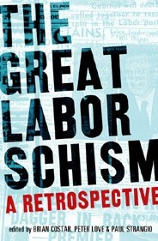
THE CHURCH IN AUSTRALIA
PARADOXES
Are we a ‘secular’ country?
Sectarianism in politics.
““the role of belief (or non-belief) are still considered to be an important factor for voters who seek to understand a prime minister’s character and actions.” (John Warhurst)

Slide 9
TOPICS
CHURCH AND STATE
SOCIAL IMPACTS
PERSONAL BELIEF

Slide 10
Church and State
Anglican foundations of all colonies except sa.
‘The State served the Anglican Church and the Anglican Church served the State’ (Tom Stannage, The People of Perth).
Embargo on Catholic priests in early NSW until 1820.
Anglicanism a more common foundation of settlement than convictism.
1825: Endowment of 1/7th of land to Anglican church.
1836-37 Church Acts: grants to other denominations.
1861 Supreme Court of NSW: Anglican church had no precedence & ecclesiastical law had no authority.
All religious associations equally free before the law.

Slide 11
Social impacts
‘In profound ways the Bible helped to shape the very dynamics of British colonialism’, whether it was ‘transporting convicts, appropriating Aboriginal land or forming settler societies. The Bible and the church were integral to colonising and imperialism.’ (Meredith Lake, The Bible in Australia).
Church involvement in education and charity
Emphasis on ‘respectability’
Churches coping with isolation e.g. bush brothers.
Culture of bible & church spread throughout society.
‘wowserism’.
Uniting Church – uniquely Australian.

Slide 12
Women in church leadership
Ordained women:
Winifred Kiek (cong. Adelaide 1927)
Isabelle Merry (Cong. Melbourne 1937)
Margaret Sanders (Meth. Perth, 1969)
Coralie Ling (Meth, Melbourne, 1969)
Marlene Thalheimer, (Pres, 1974)
Churches of Christ (1973) and Baptists (1978)
By 1977, 33 women had been ordained.
1991: Presbyterian Church rescinded permission for women to be ordained.
1990s: first Anglican women ordained.
Catholics still refusing to ordain women.

Slide 13
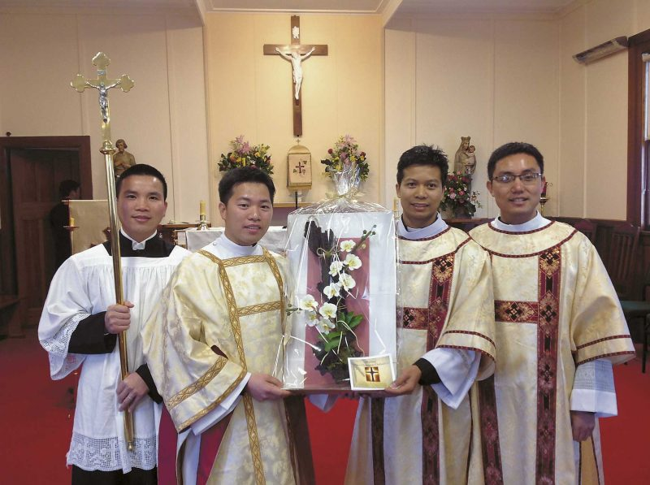
Changes in Church Populations
68% population ‘Christian’
81% Anglican, Catholic or Uniting.
11,415 men & 2,823 women ministers
(2001 census)
By 1927, approx. 10,000 Greeks
Setting up of Orthodox congregations.
Impact of post-World War II migrant populations.
30% of Vietnamese refugees were Catholic
Vietnamese priests and congregations impacting upon Catholicism.

Slide 14
EVENTS

Slide 15
Impacts of 1959 Billy Graham Crusade
Bureau of Statistics – a 10% reduction in alcohol consumption for 1960-61.
Australian Crime Statistics – a brief halt in the increase of crime for 1960-62.
1960 recorded fewer ex-nuptial births in a decade in which the figure had been steadily growing.
Businesses reported an “epidemic” of repayments of bad debts
burglars handed in the tools of their trade when coming forward. Even a revolver!
A Sydney District Court magistrate reported a 50% drop in alcohol-related crime.
In 1969, more than 50% of Melbourne Bible Institute’s 160 students & 25% of Adelaide Bible Institute’s 118 students enrolled due to the 1959 Crusade.
Many of the leaders and personnel of missionary organisations, like CMS, or Wycliffe Bible Translators had been impacted by the 1959 Crusade.
During the Crusades, sales of Bibles trebled in capital cities.
Scripture Union memberships almost doubled between March 1958 and November 1959 (from 58,000 to 104,400).

Slide 16
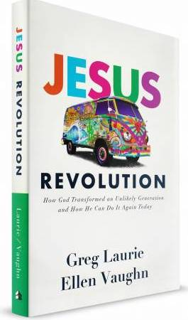

Slide 17
Where are we now?
Australia has approx. 13,000 churches.
1.8 million Australians attend a church service each week (that’s out of a population approaching 25 million).
The latest Census results show that 61% of Australians identify with Christianity. (The second most popular religion in Australia is Buddhism (2.5%),
Less than one in seven of the Australians who ticked “Christianity” on their census form regularly attend a church.
https://mccrindle.com.au/insights/blogarchive/church-attendance-in-australia-infographic/

Slide 18
2013 survey – why people don’t go to church
Irrelevant to my life (47%)
Don’t accept how it’s taught (26%)
Outdated style (24%)
Issues with clergy (22%)
Don’t believe the Bible (19%)
Too busy to attend (18%)

Slide 19
sources
Meredith Lake, The Bible in Australia (Sydney: New South Publishing, 2020 edition).
Muriel Porter, ‘Christian Church Ministry’ in The Encyclopedia of Women & Leadership in Twentieth Century Australia, accessed on 19 February 2021 at: http://www.womenaustralia.info/leaders/biogs/WLE0032b.htm
C.T. Stannage, the people of perth (perth: Perth city council, 1979).
https://mccrindle.com.au/insights/blogarchive/church-attendance-in-australia-infographic/
https://comparecamp.com/church-attendance-statistics/

